Slide 1
Innovative Collaborations: Enhance Your Teaching, Enrich Student Learning
Ginger Holden,
Learning Communities Coordinator

Slide 2
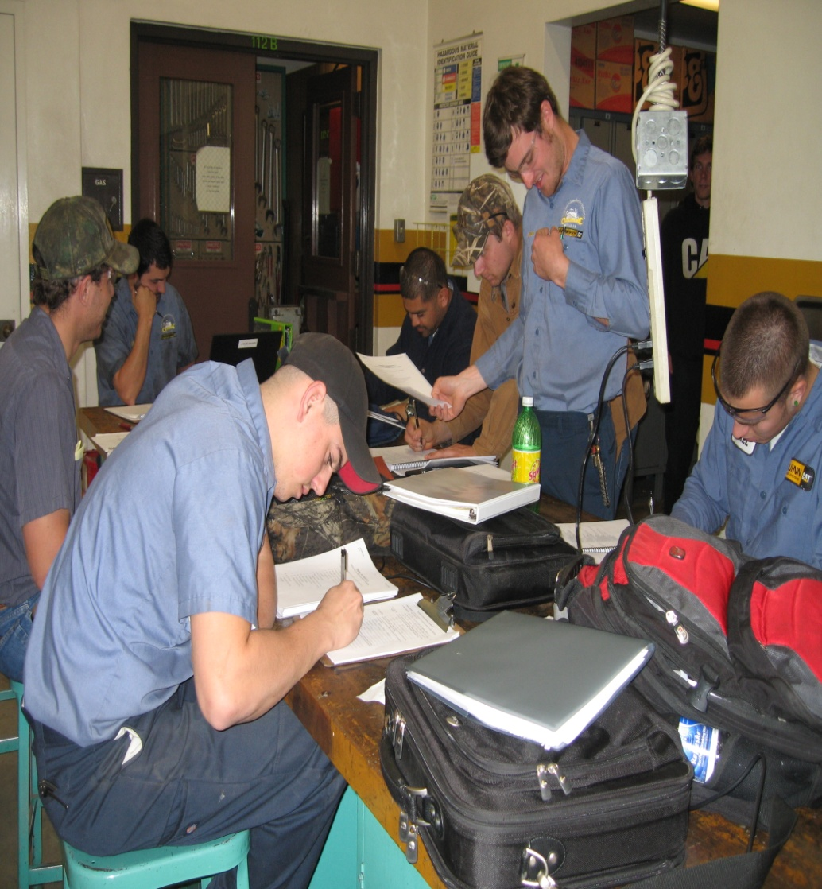
Learning Communities
Student-centered
Collaborative
Faculty-driven

Slide 3
Workshop Objectives
Provide overview of learning communities at SJDC
Review and address learning community challenges
Introduce Delta’s learning communities website
Share steps to forming a learning community
Present key ways to link learning community classes

Slide 4

What is a Learning Community?
Two or more classes linked together by a common theme or context
Class assignments and/or activities in one class relate to the other class(es) in the community
The same students enroll in all classes within the learning community
A sense of “community” is fostered among students and faculty

Slide 5

What Makes a Learning Community Successful?
Course content is relevant to students’ career or personal interests
Students meet others who share common goals
Faculty and students experience greater interaction
Significant number of students are retained in classes

Slide 6
Learning Communities Work Best When . . .
Faculty members are compatible
Courses compliment one another
Students traditionally take courses together

Slide 7
Learning Community Challenges
High numbers of at-risk students
A classroom of well-acquainted students (a.k.a. “The Socialization Issue”)
Lack of communication between faculty members
Finding common ground to create multiple integrated assignments
Absence of faculty collaboration or students’ perceived absence of collaboration (i.e. unclear linked assignments)

Slide 8
Learning Communities Website
A Student and Faculty Resource
Learning Communities

Slide 9
Steps to Forming a Learning Community
Discuss LC concept with Learning Communities coordinator
Find faculty with whom you would like to collaborate
With LC partner(s), create learning community theme and description
Submit theme and description along with learning community class information to LC coordinator
Sign Learning Communities Request Form
Attend learning communities faculty workshop the semester prior to teaching in your community

Slide 10
Ways to Link Learning Community Classes
Create theme and accompanying description to represent your learning community
Establish shared class policies
Design integrated assignments and/or activities

Slide 11
Small Group Activity
In groups of 2-3, discuss the questions listed in the adjacent column. Be prepared to share your responses with the larger group.
What kind of learning communities (course “unions”) do you consider most beneficial to Delta’s students?
Within what new or existing learning community would you enjoy being a faculty participant?

Slide 12
Workshop Summary
Learning communities provide innovative curricular opportunities for faculty to stimulate their teaching and increase student learning
Learning communities WORK when they contain: integrated assignments, instructors who enjoy working together and regularly communicate, and students who enroll in all classes within the community
For additional faculty resources, detailed learning community descriptions, and general learning communities information, access Delta’s Learning Communities website

Slide 13
Questions?

