Slide 1
Fall 2010 Outstanding Students
Tonight we are honoring students from:
Agriculture, Science, and Mathematics
Counseling & Special Services
Humanities, Social Sciences, & Education
Applied Science, Business, and Technology

Slide 2
Agriculture, Science & Mathematics

Slide 3
Matthew Roche

Slide 4
Jannine Spann

Slide 5
Katherine Vaca

Slide 6
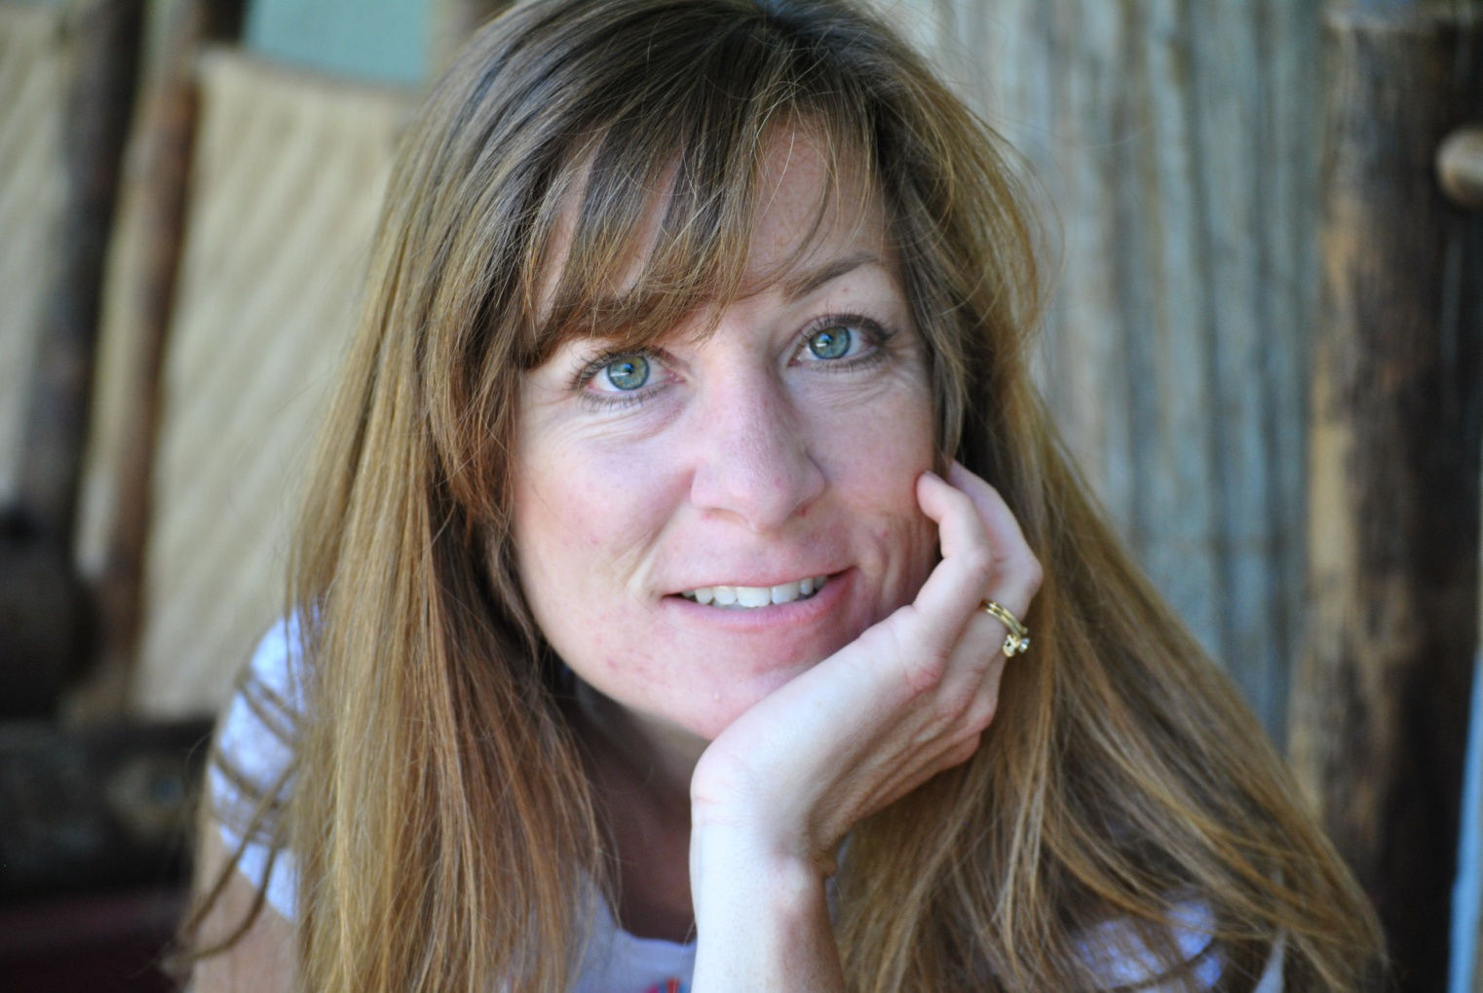
Yvonne Knaggs

Slide 7
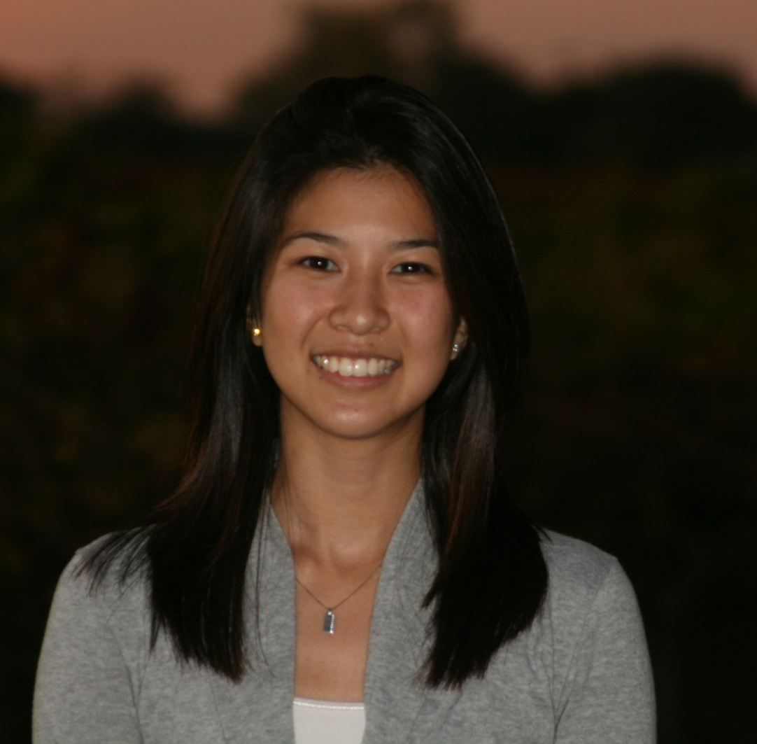
Christine Fujinaka

Slide 8
Vicki Kirk

Slide 9
Julia Pasterski

Slide 10
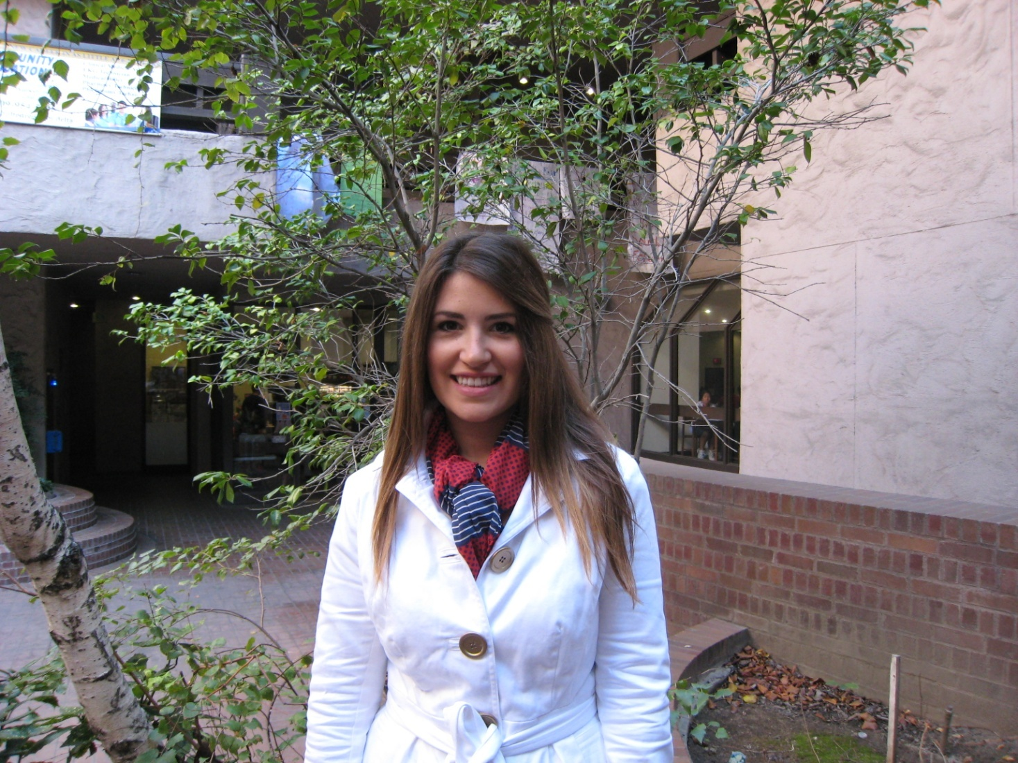
Jane Pierce

Slide 11
Michelle Pereira

Slide 12
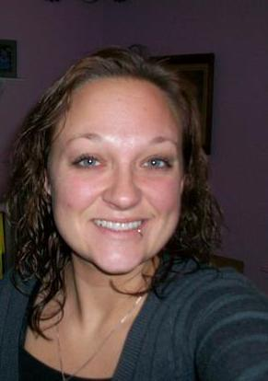
Candace Green

Slide 13
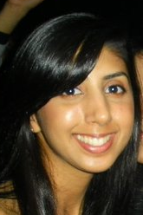
Lovedeep Bains

Slide 14
Herlinda Menchaca

Slide 15
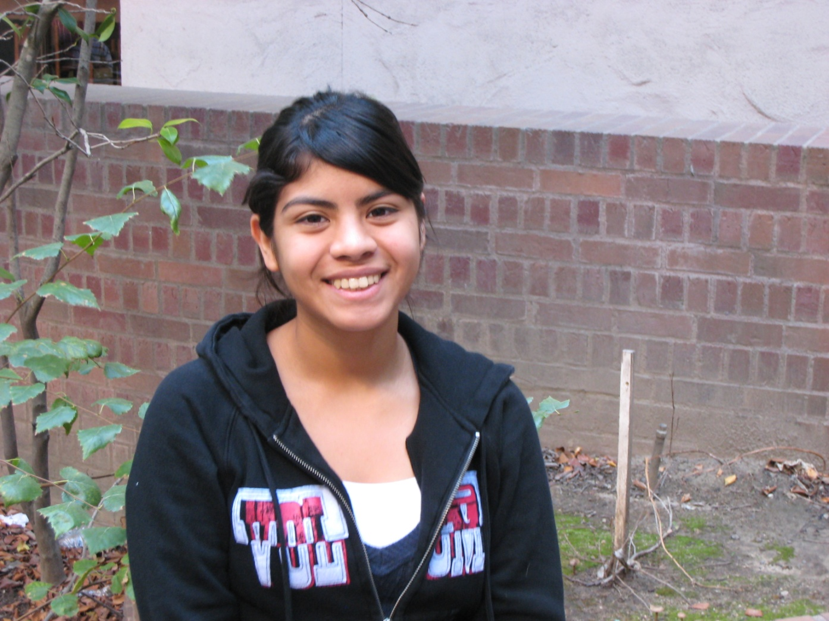
Annel Pineda

Slide 16
Karla Solis

Slide 17
Alexander Valencia

Slide 18
Counseling & Special Services

Slide 19
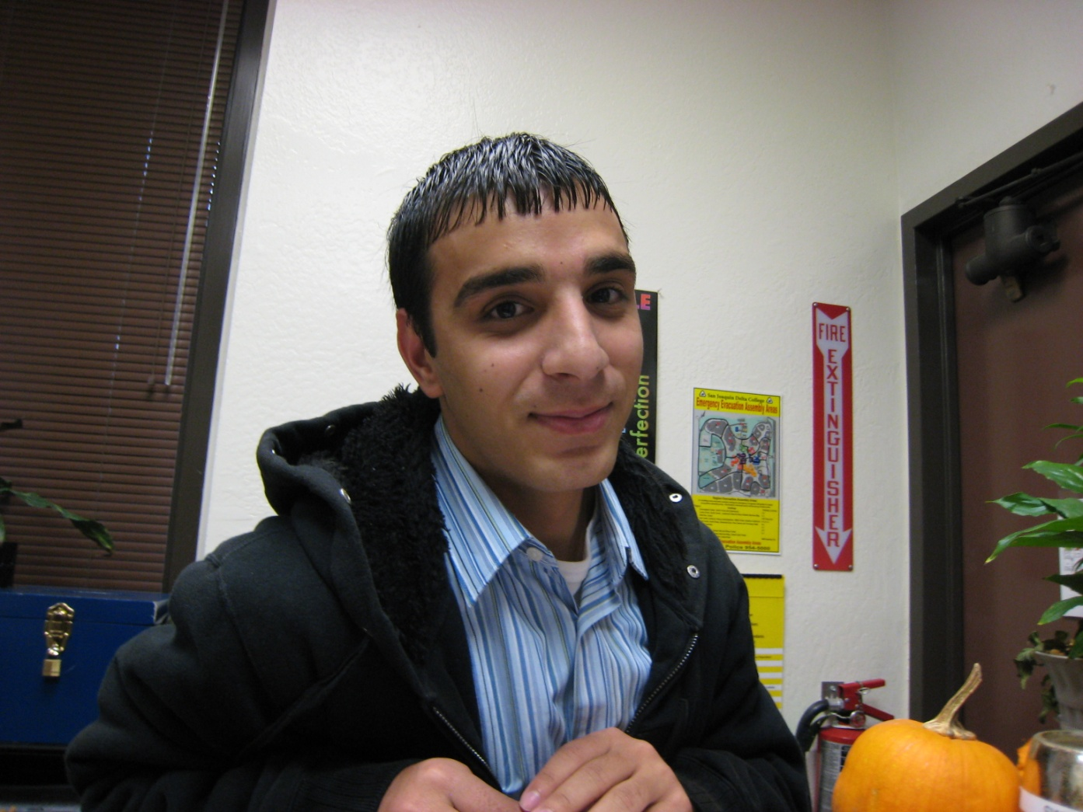
Nasir Hakim

Slide 20
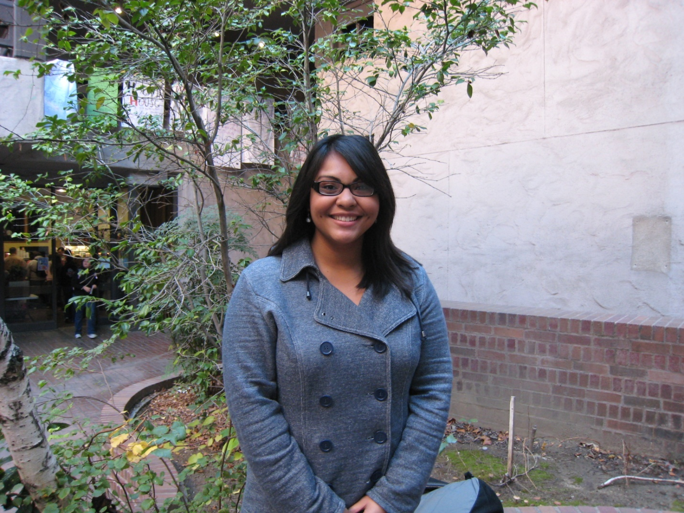
Jessica Lazo

Slide 21
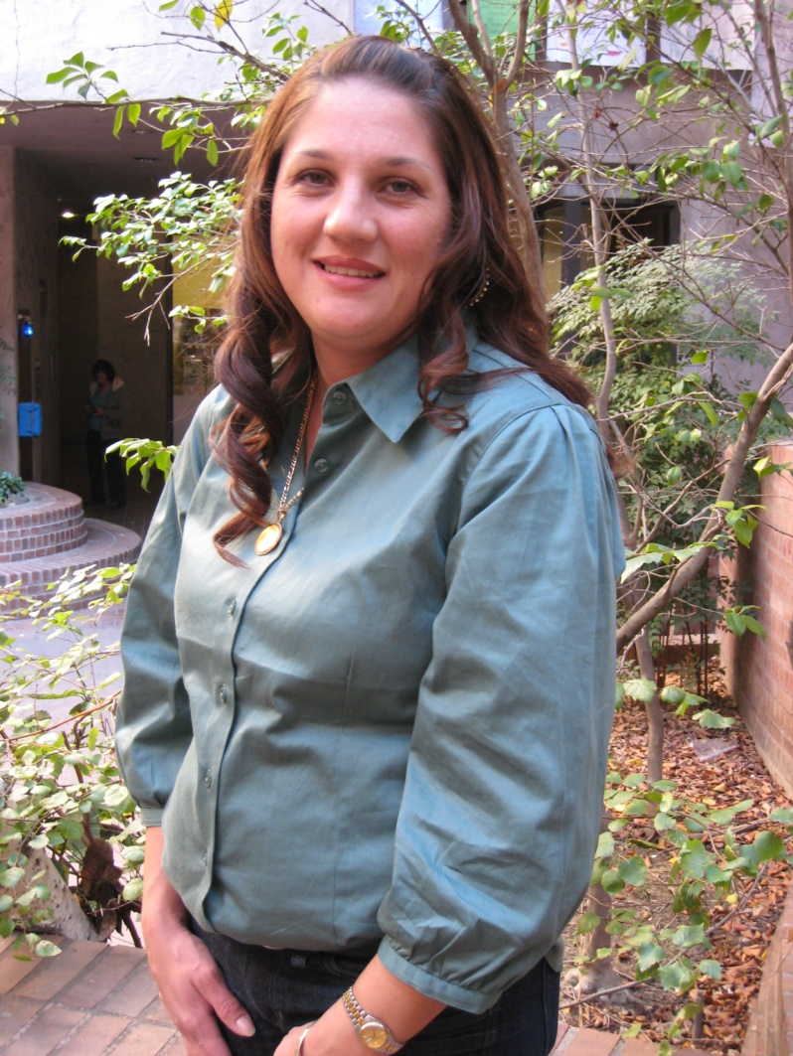
Jeanne Mendoza

Slide 22
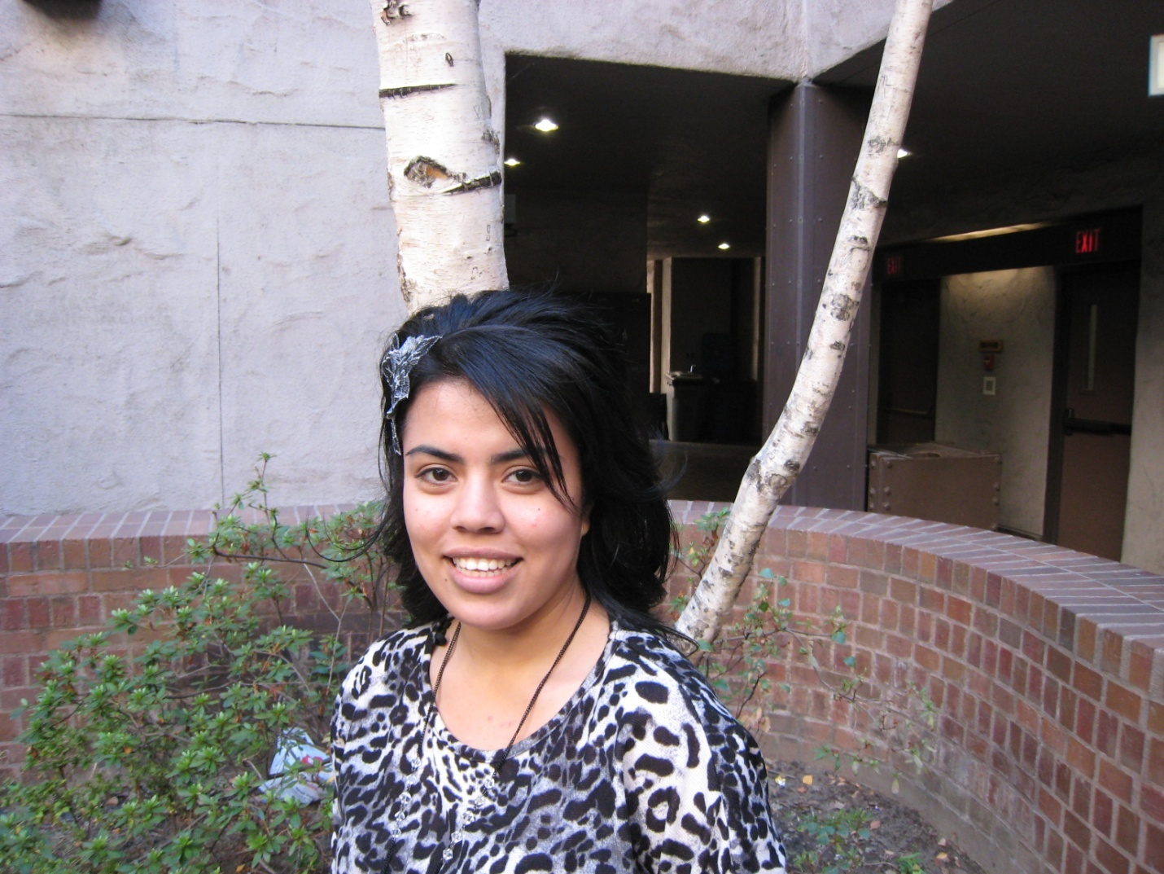
Jazmin Hernandez

Slide 23
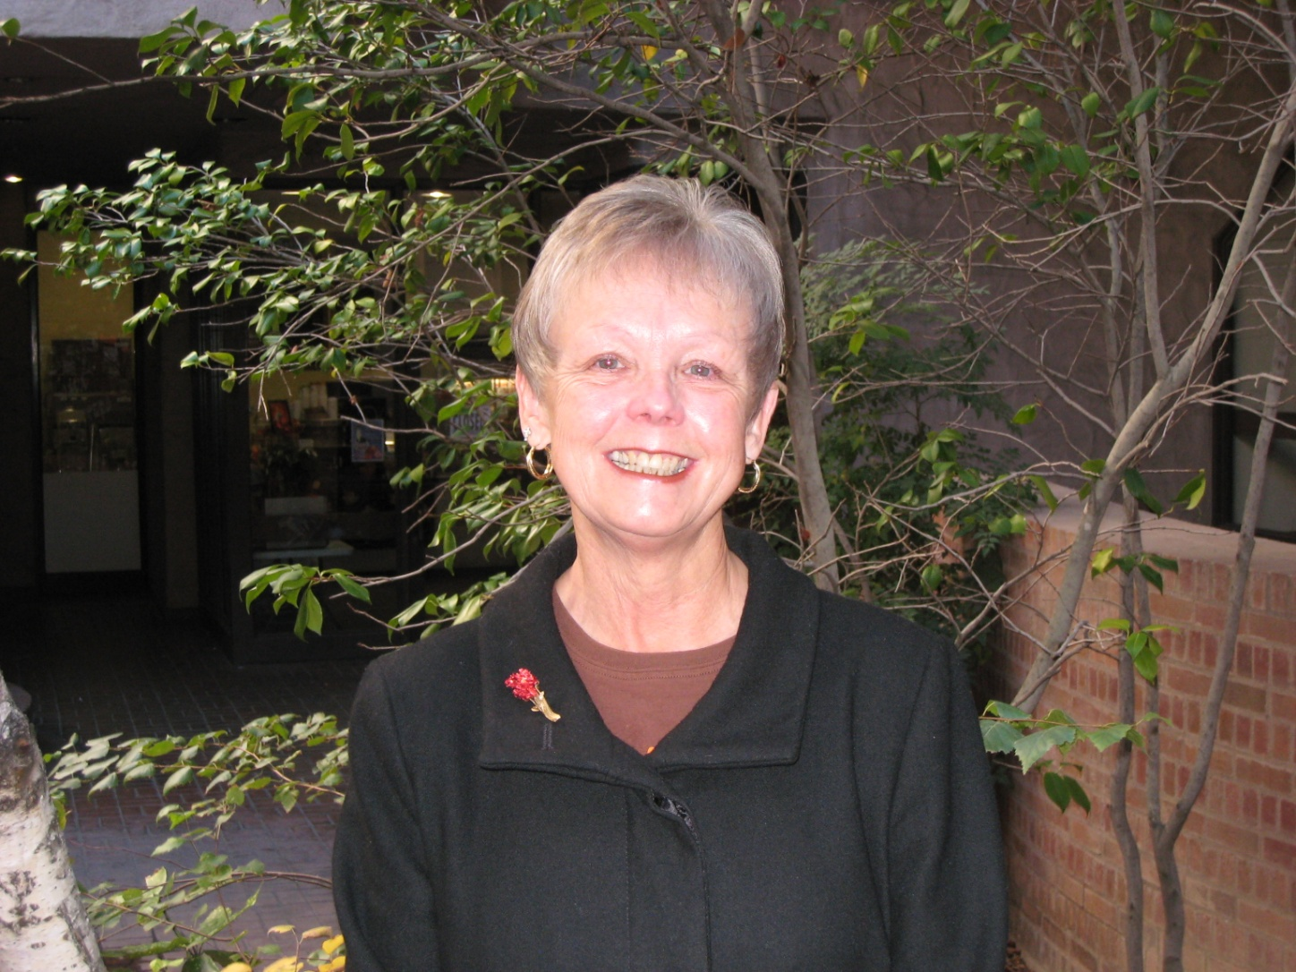
Gail Lopez

Slide 24
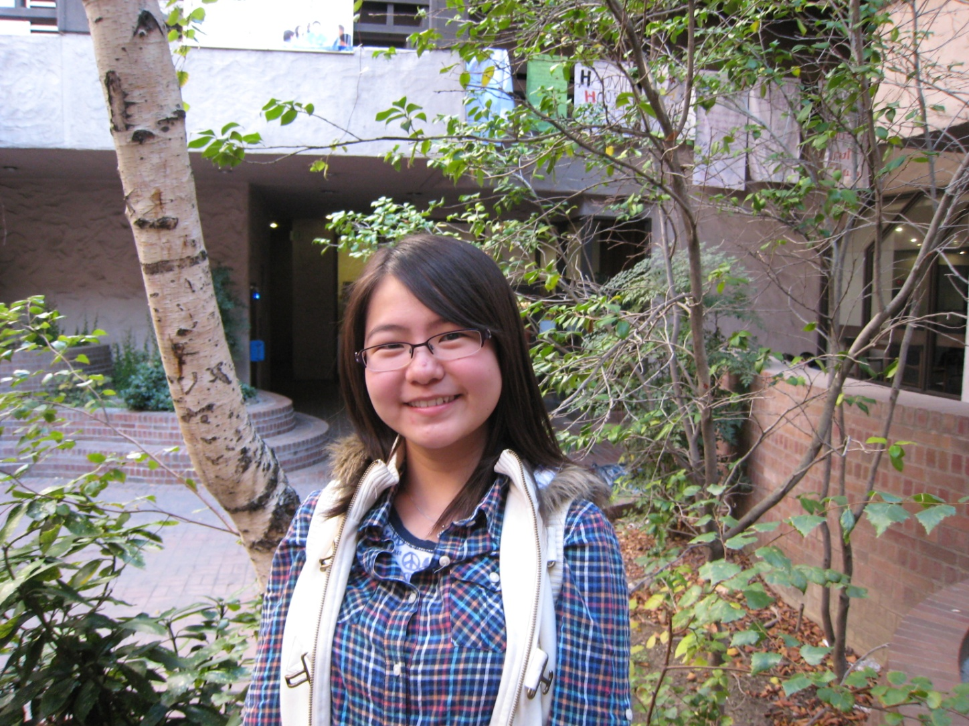
Yuanming Mei

Slide 25
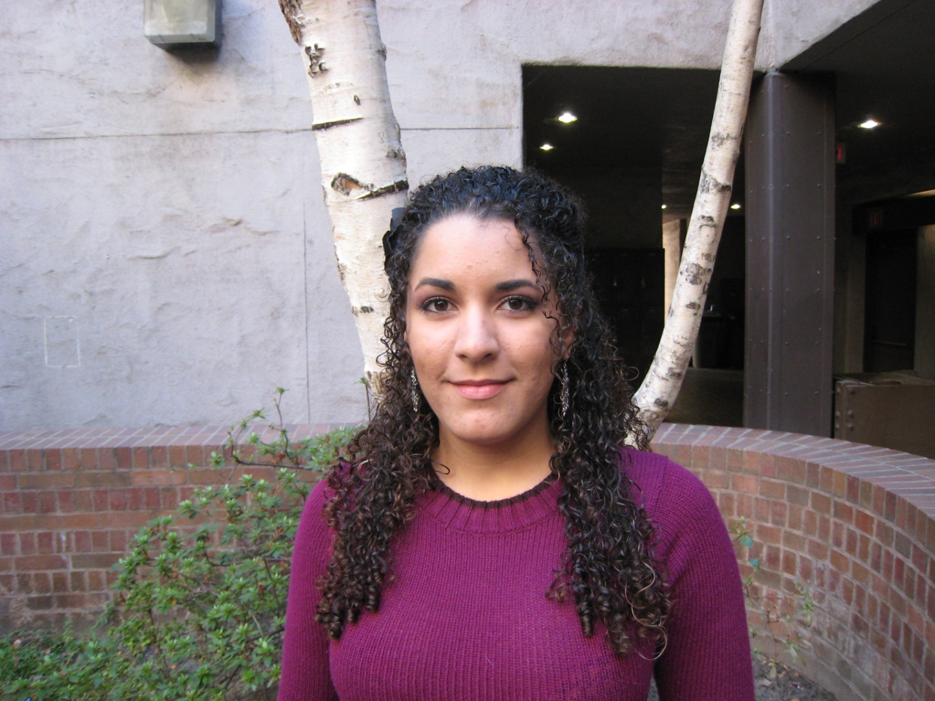
Stephanie Mercado

Slide 26
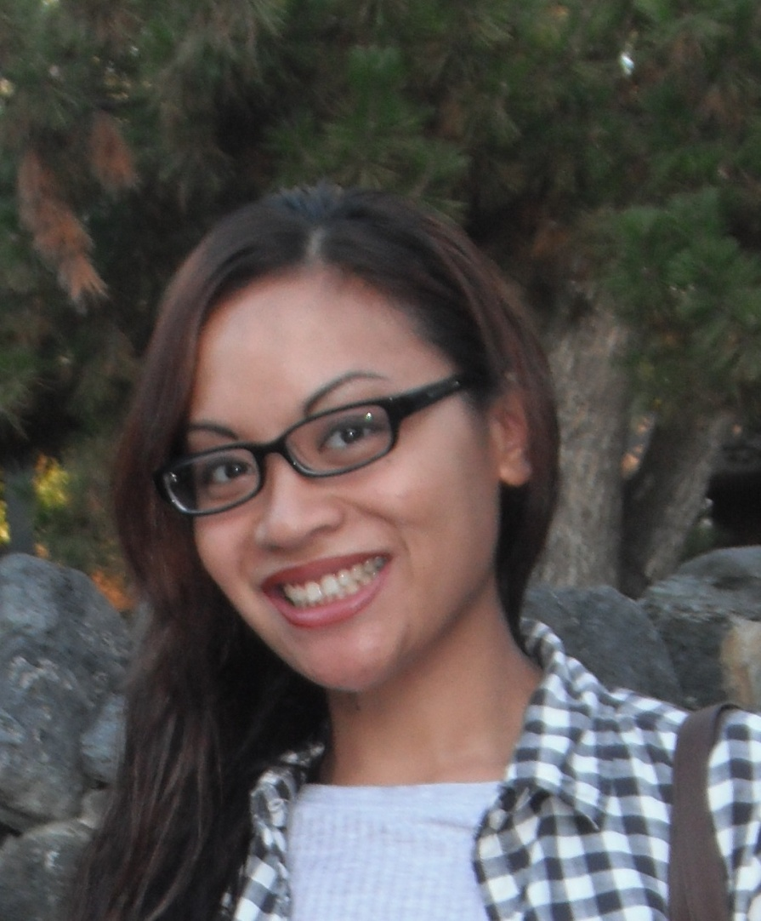
Chloe Diaz

Slide 27
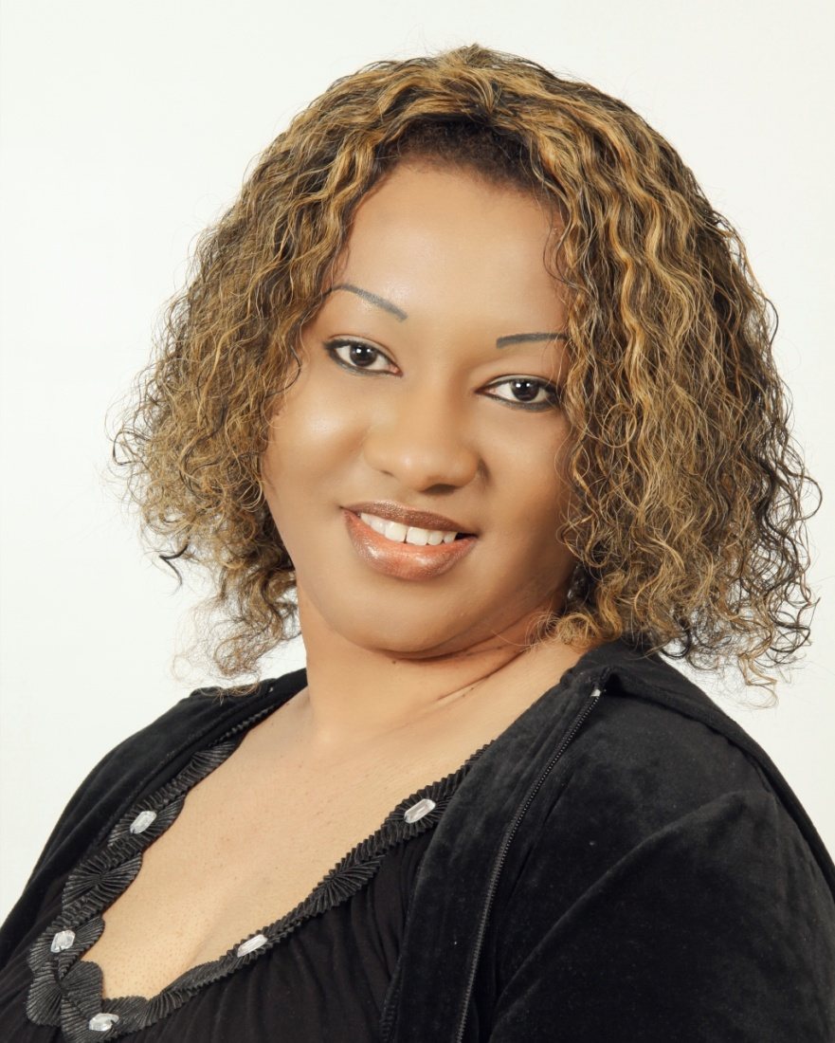
Rose Esotu

Slide 28
Christina Hine

Slide 29
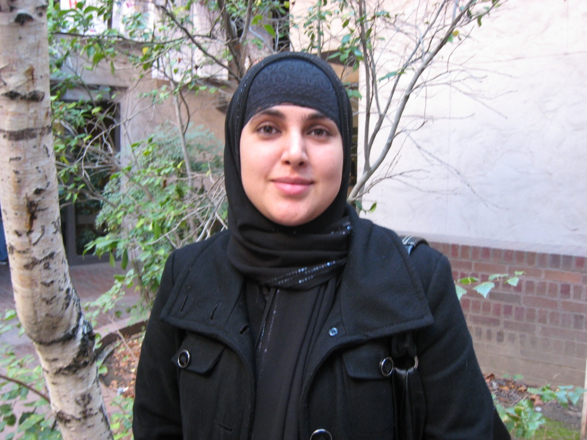
Samra Jameel

Slide 30
Lue Thao

Slide 31
Humanities, Social Science, & Education

Slide 32
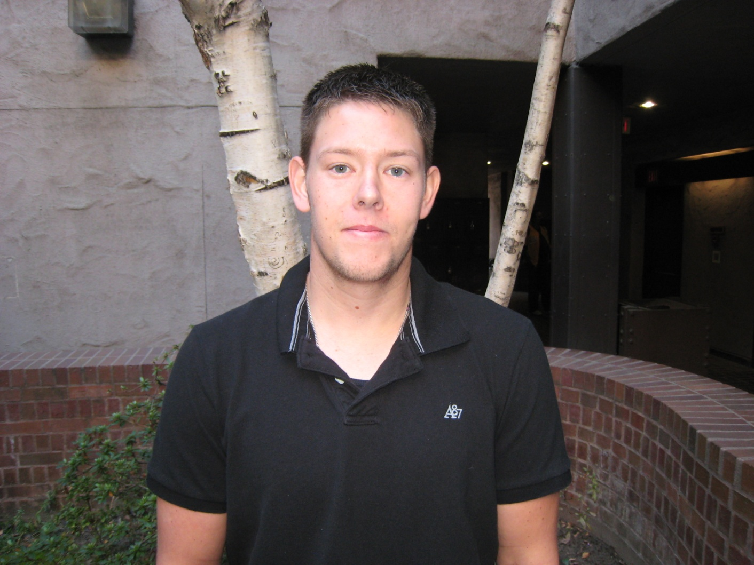
Robert Parmley

Slide 33
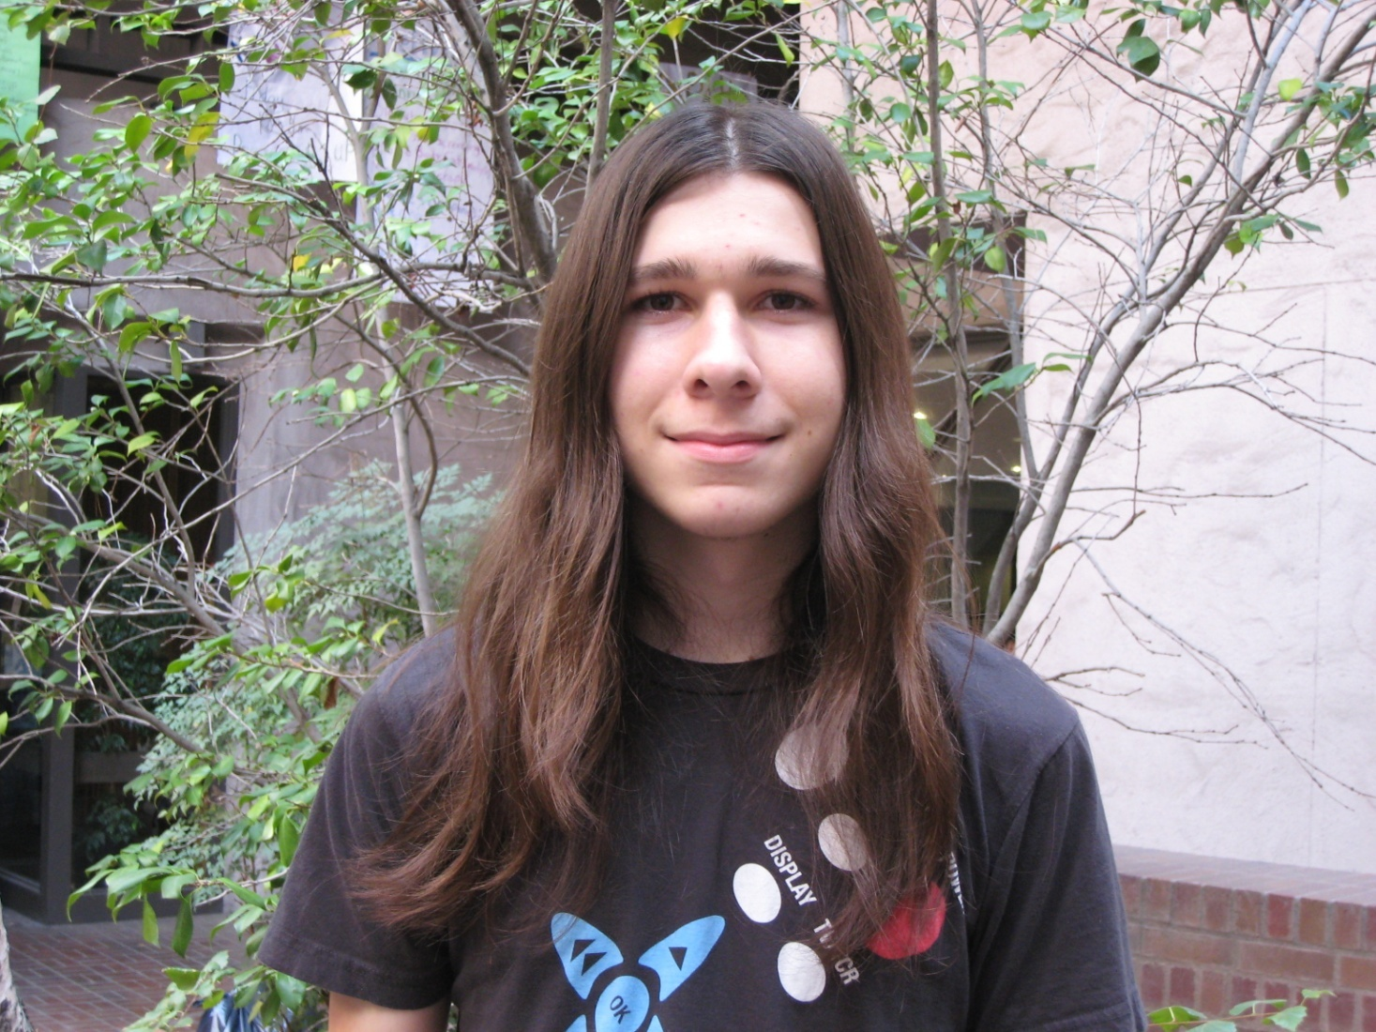
Kenneth Terzi

Slide 34
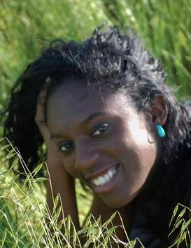
Taquesah Thomas

Slide 35
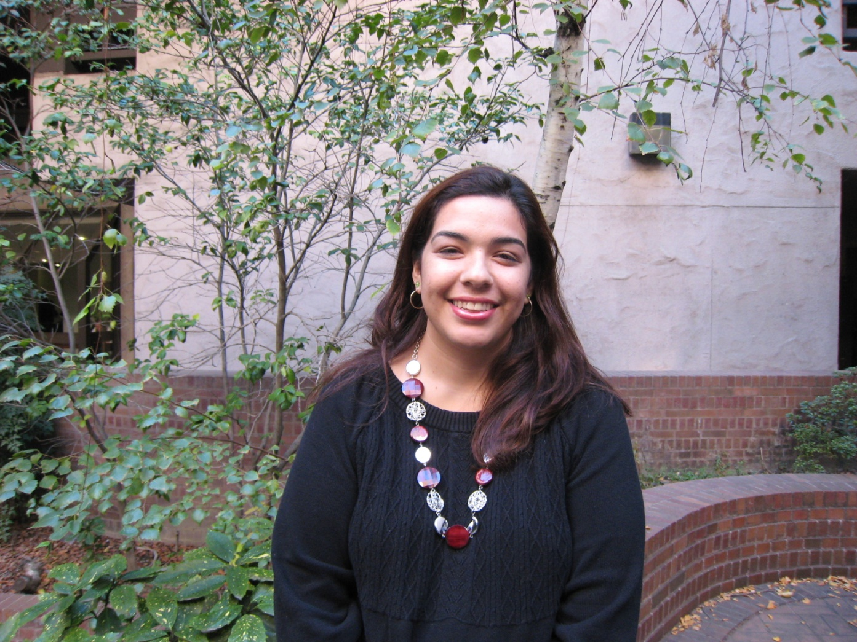
Claudia Gonzalez

Slide 36
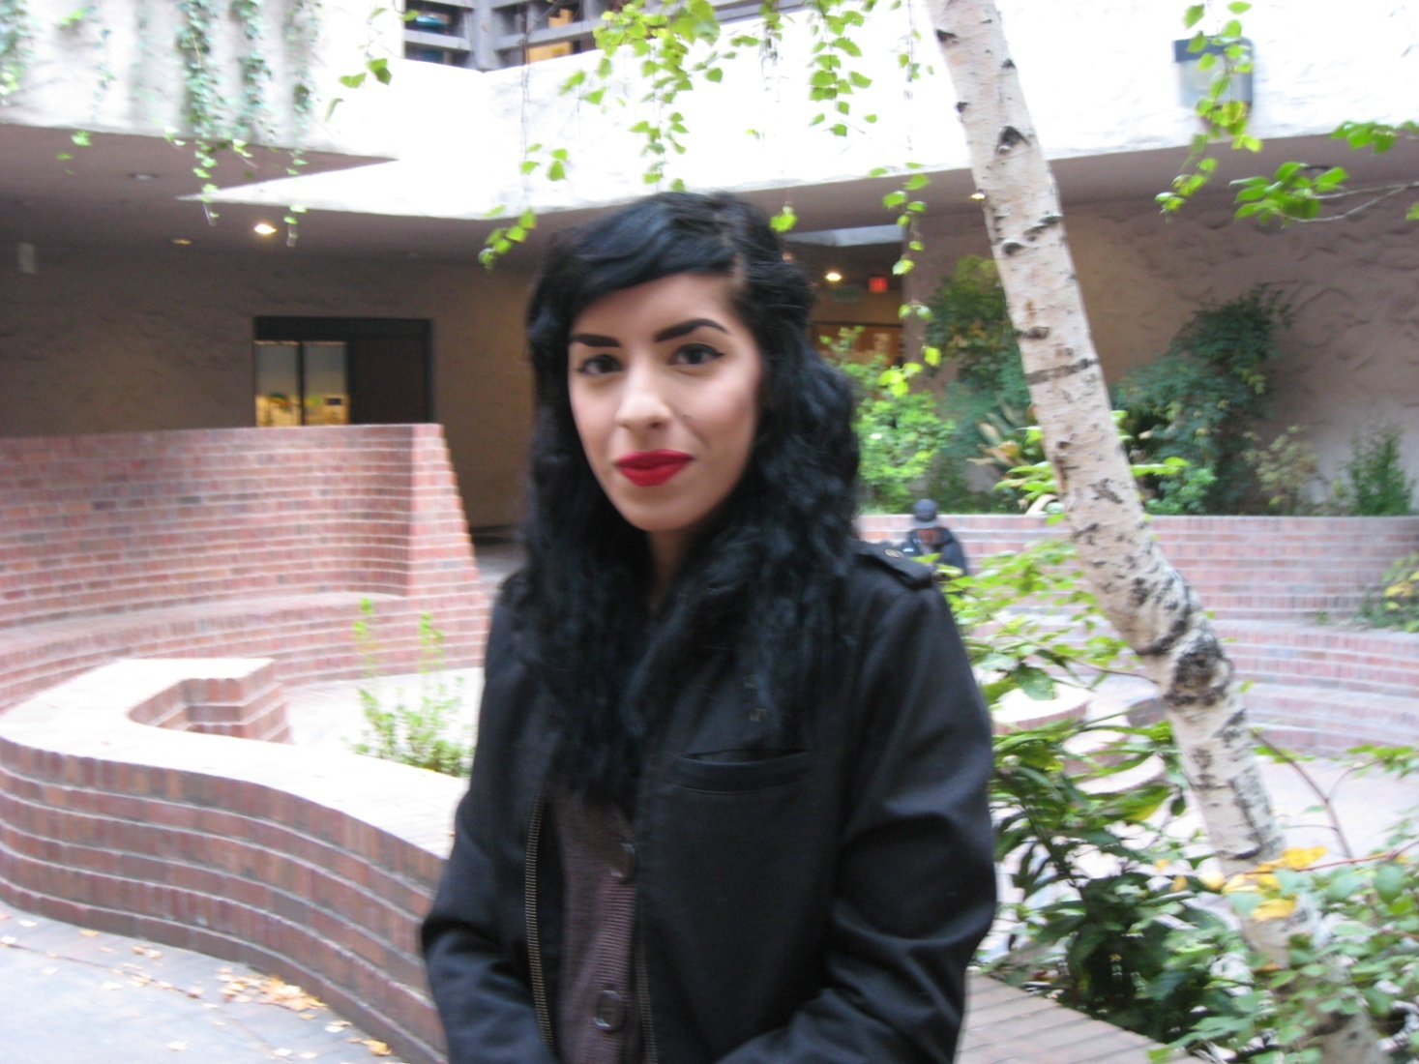
Chynna Andeola

Slide 37
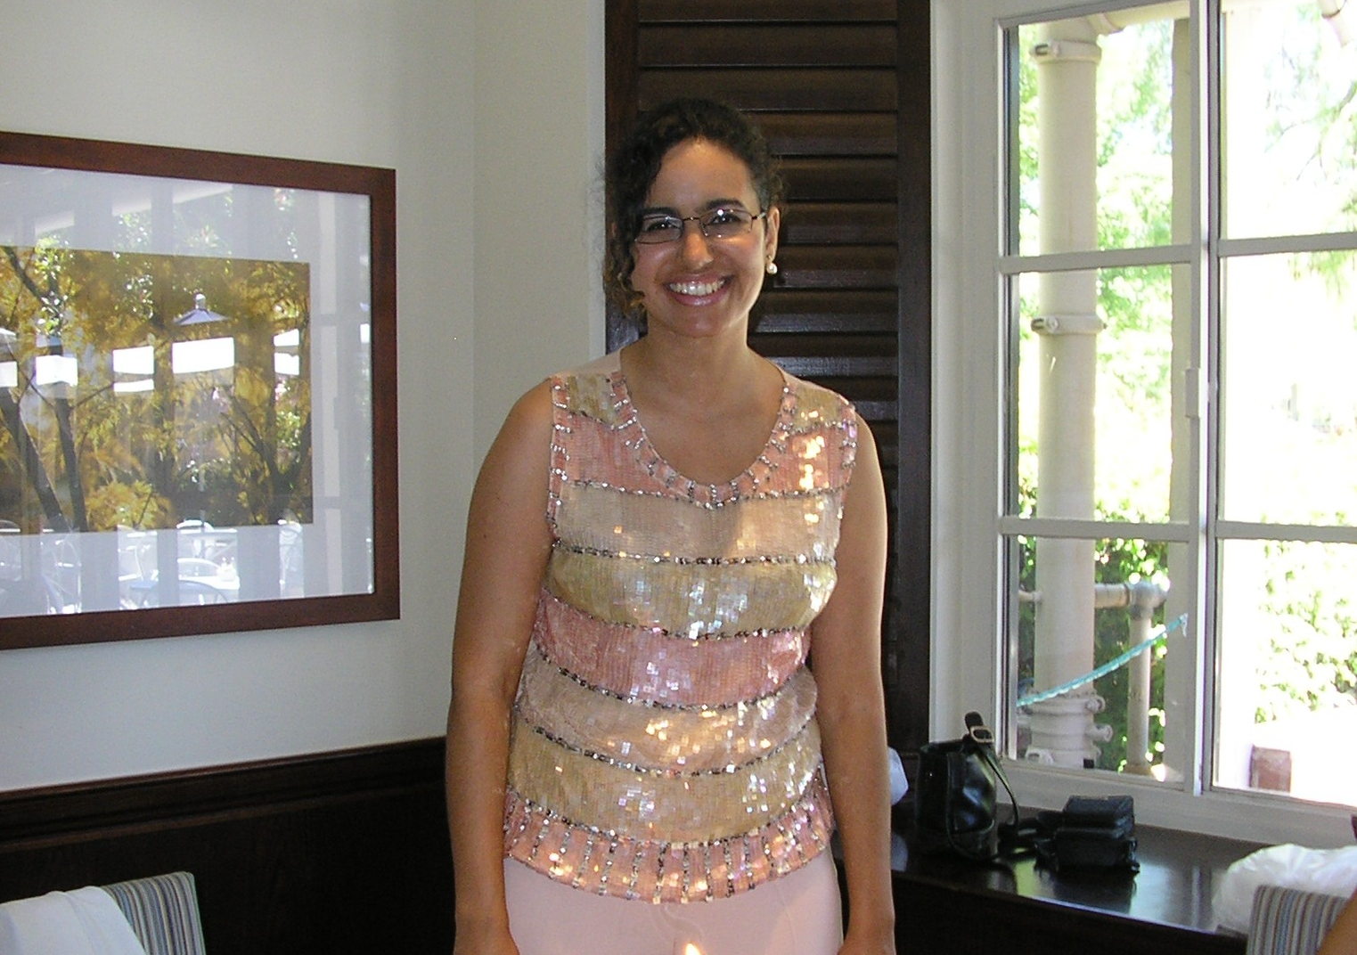
Hind Lalami

Slide 38
Peter Racco

Slide 39
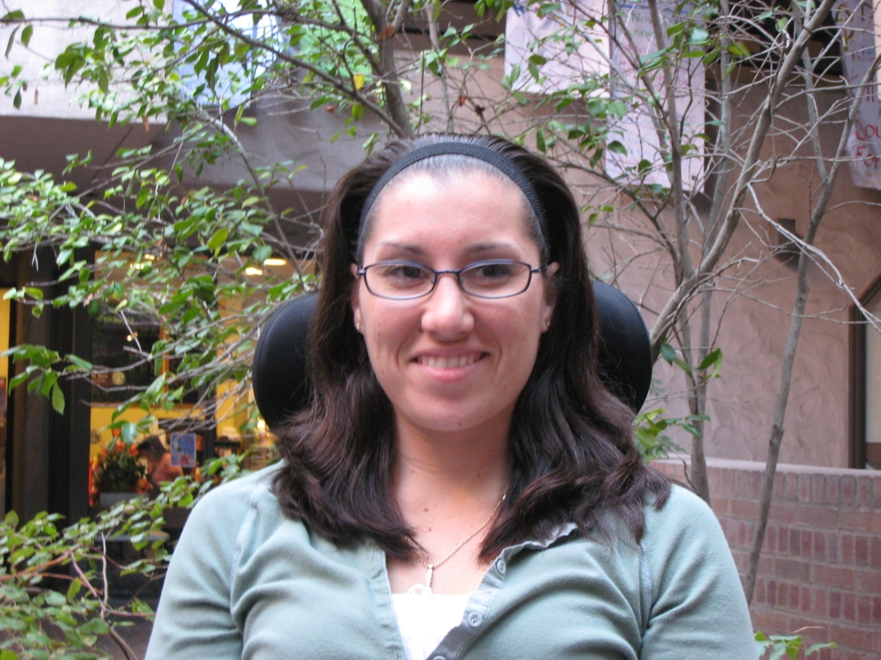
Sarah Watchers

Slide 40
Brandon Chaffin

Slide 41
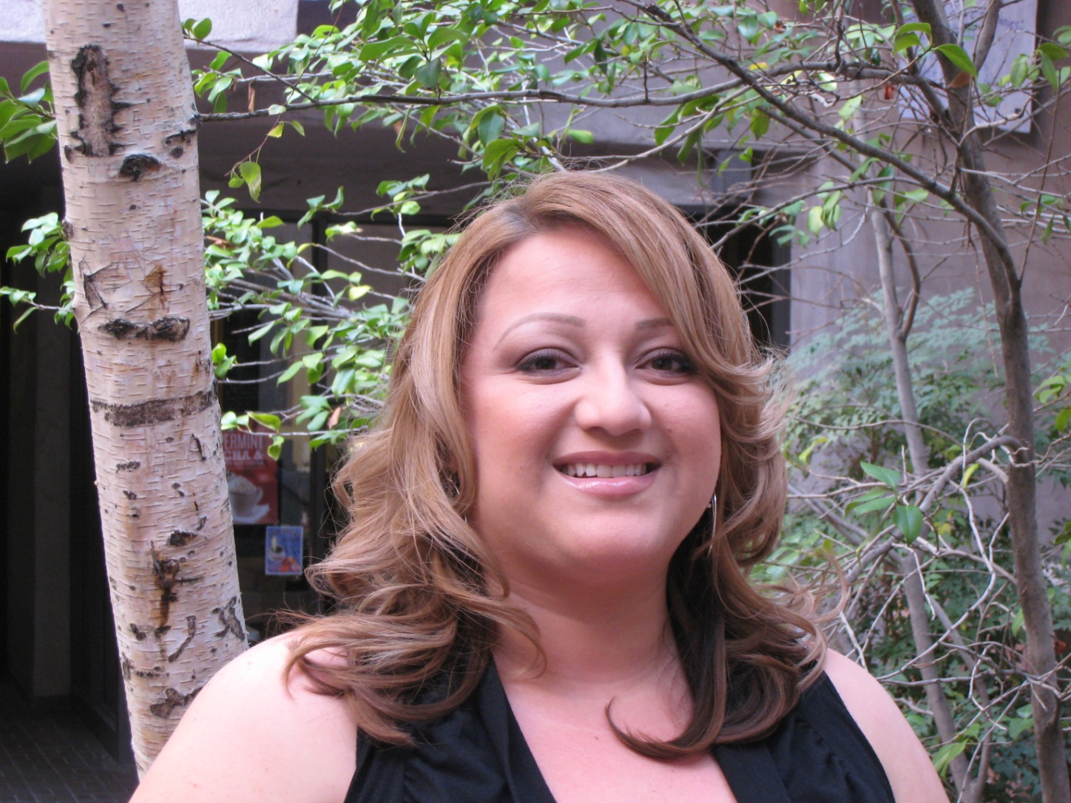
Michele Colin

Slide 42
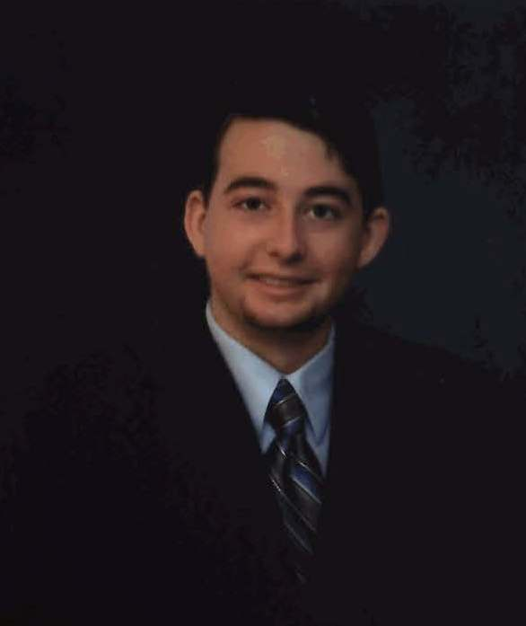
Ryan Gresham

Slide 43
Alicia Kidd

Slide 44
Scott Lusher

Slide 45
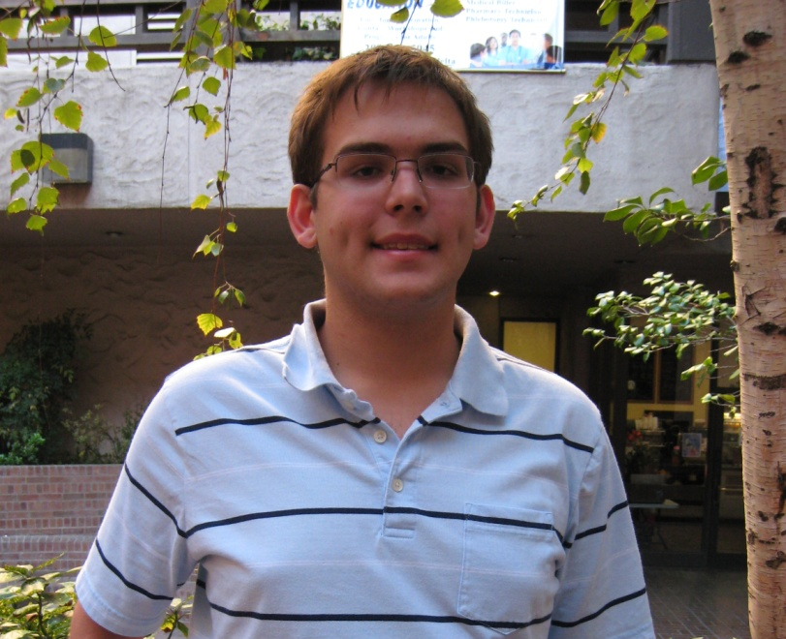
William Jefferson

Slide 46
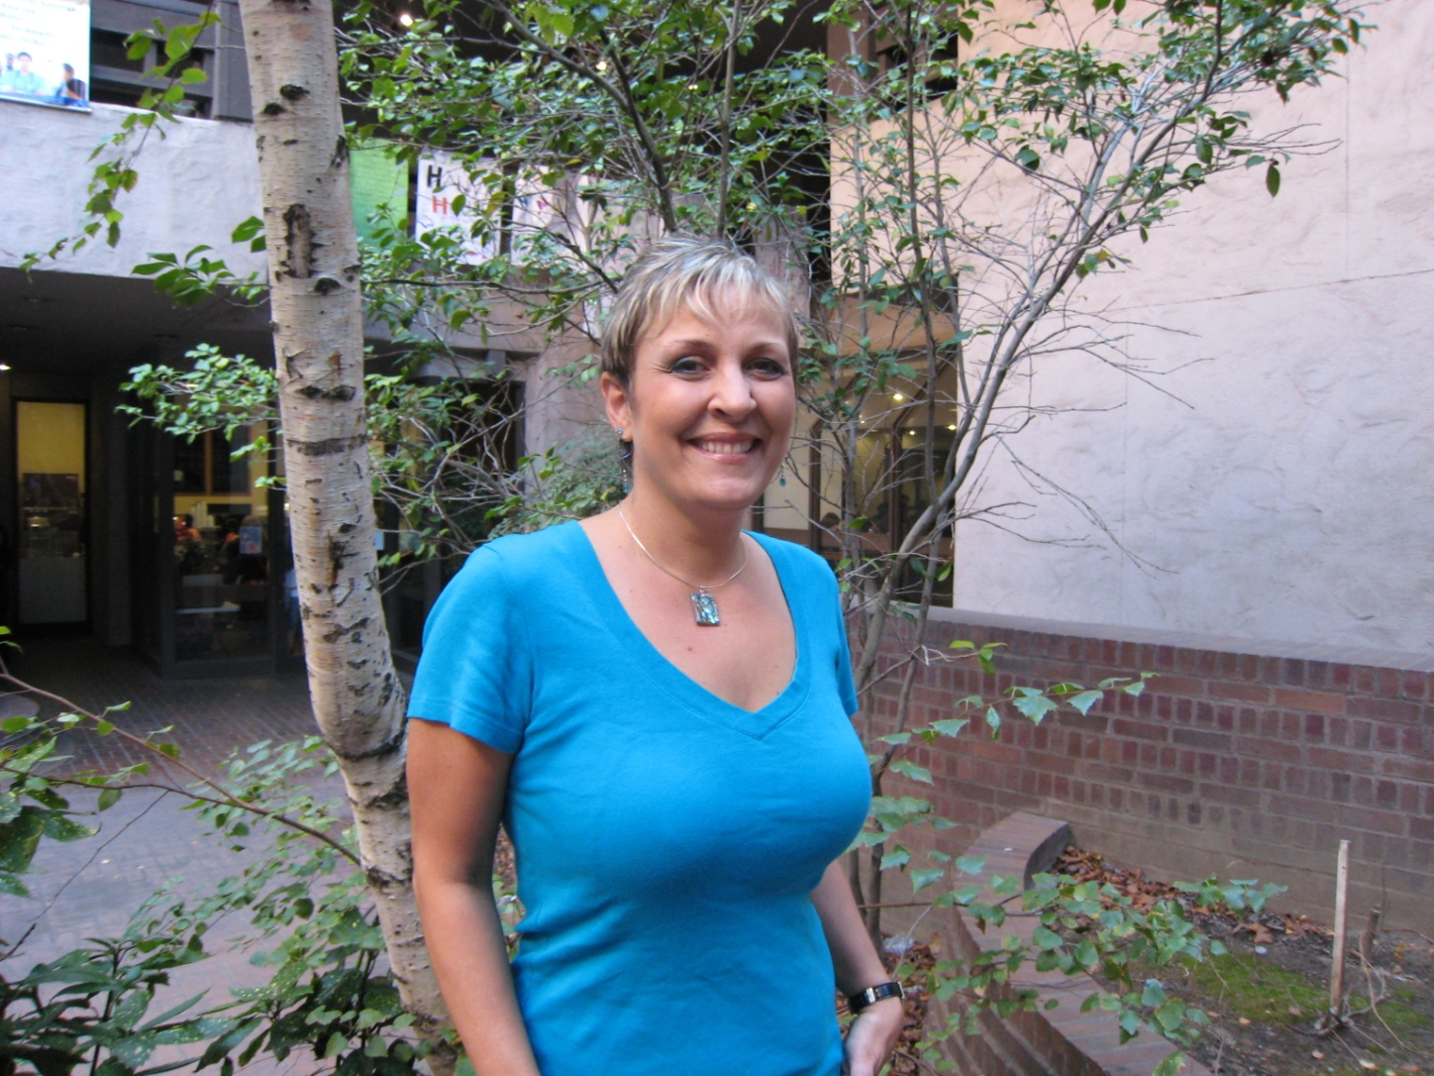
Cheryl Dodge

Slide 47
Applied Science, Business, & Technology

Slide 48
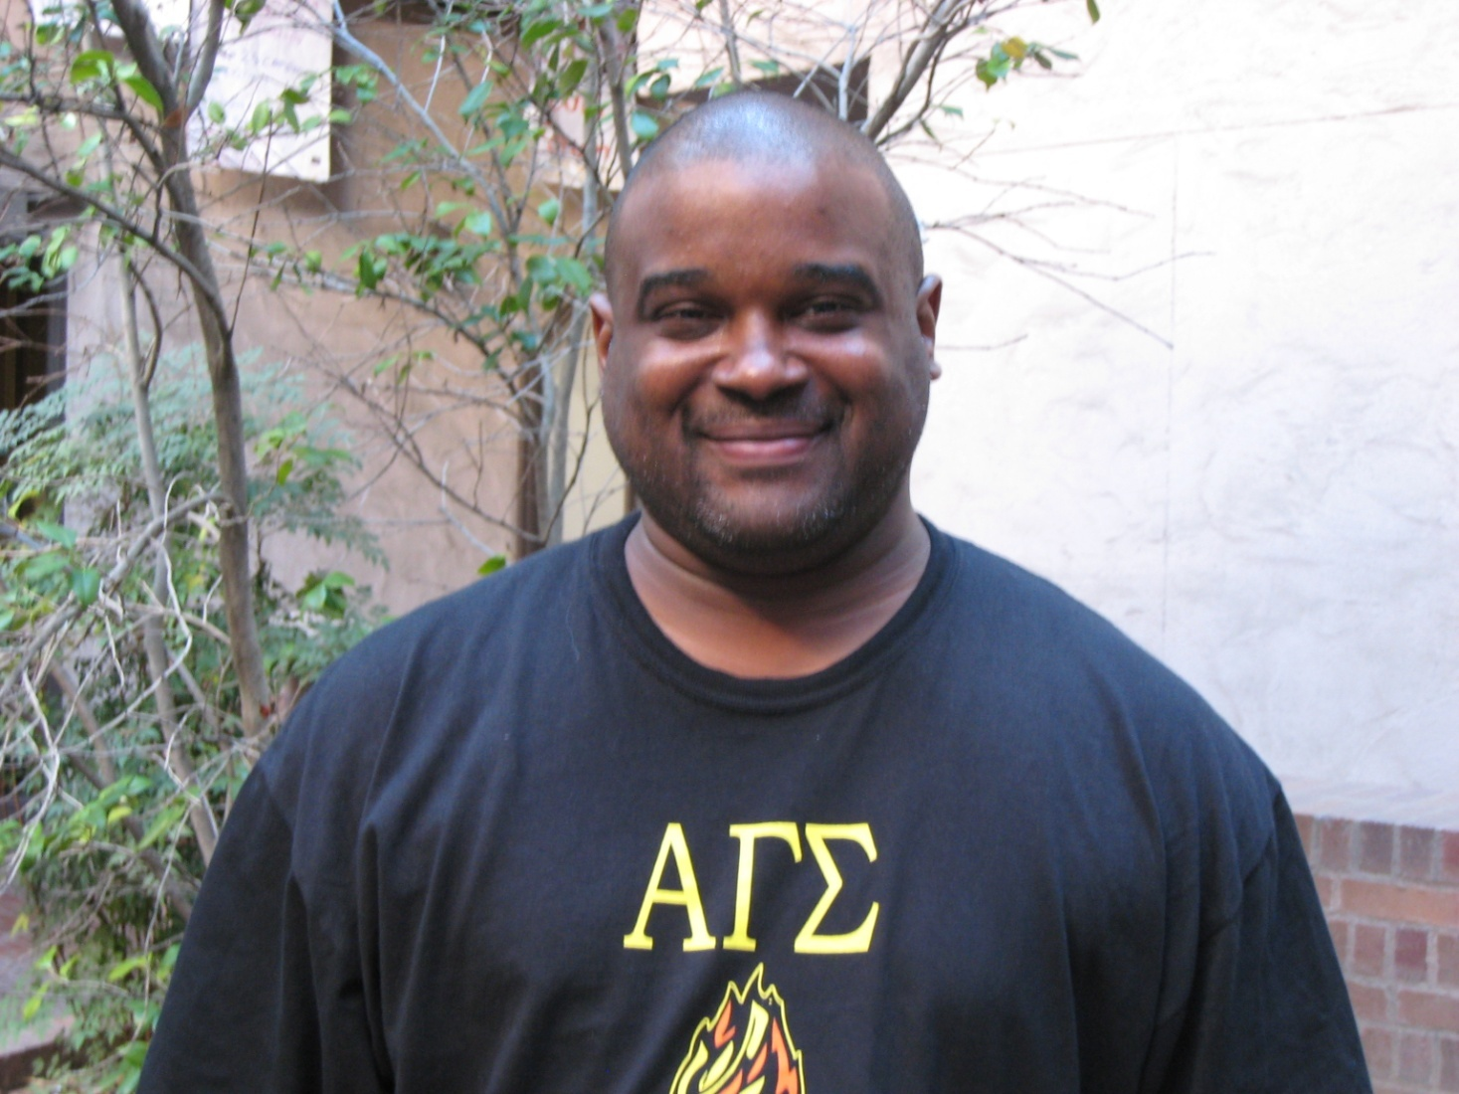
Clayton Avery

Slide 49
Nancy Borders

Slide 50
Jason Bumgard

Slide 51
Antonio Correa

Slide 52
Mariana Gayton

Slide 53
Ivan Guzman

Slide 54
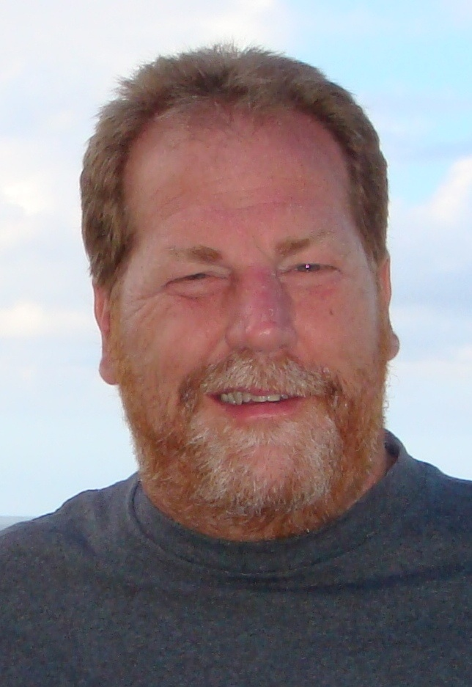
Troy Hollingsworth

Slide 55
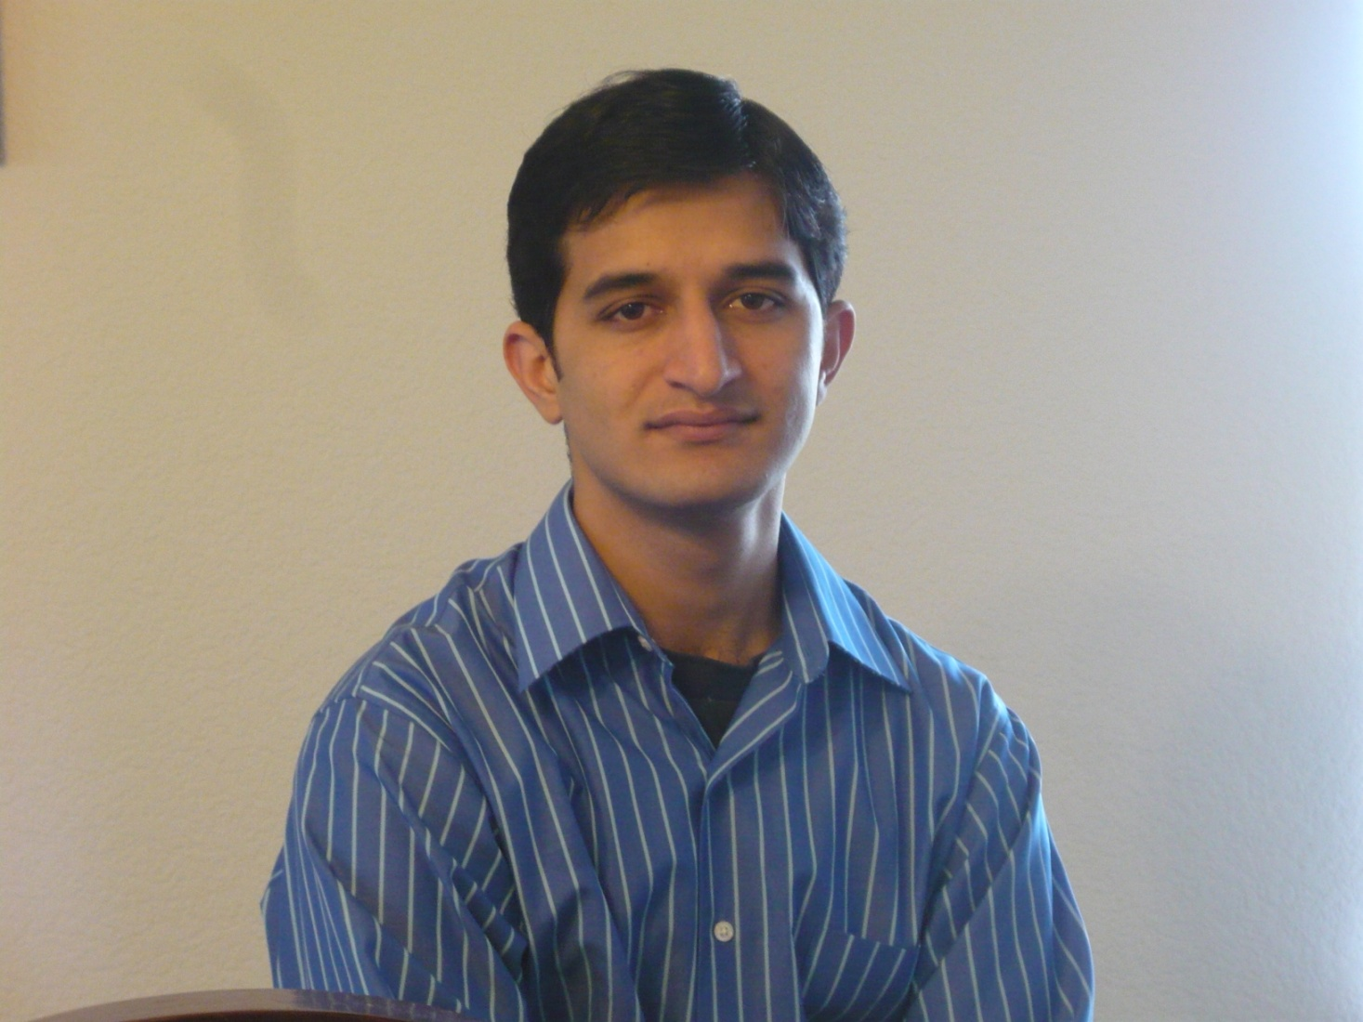
Zohaib Kayani

Slide 56
Ryan Lind

Slide 57
Ahnie Lopez

Slide 58
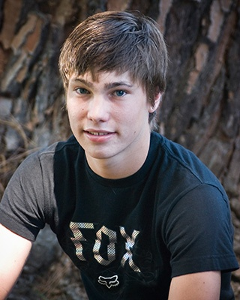
Joshua Tomlinson

Slide 59
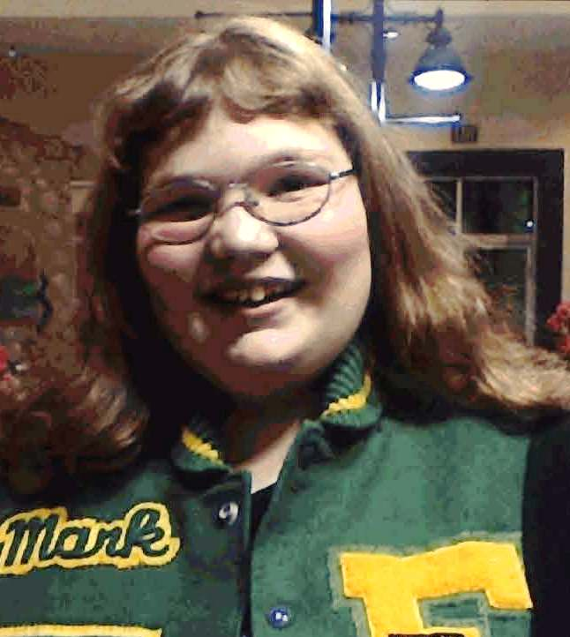
Amanda Utterback

Slide 60
Gary Church

Slide 61
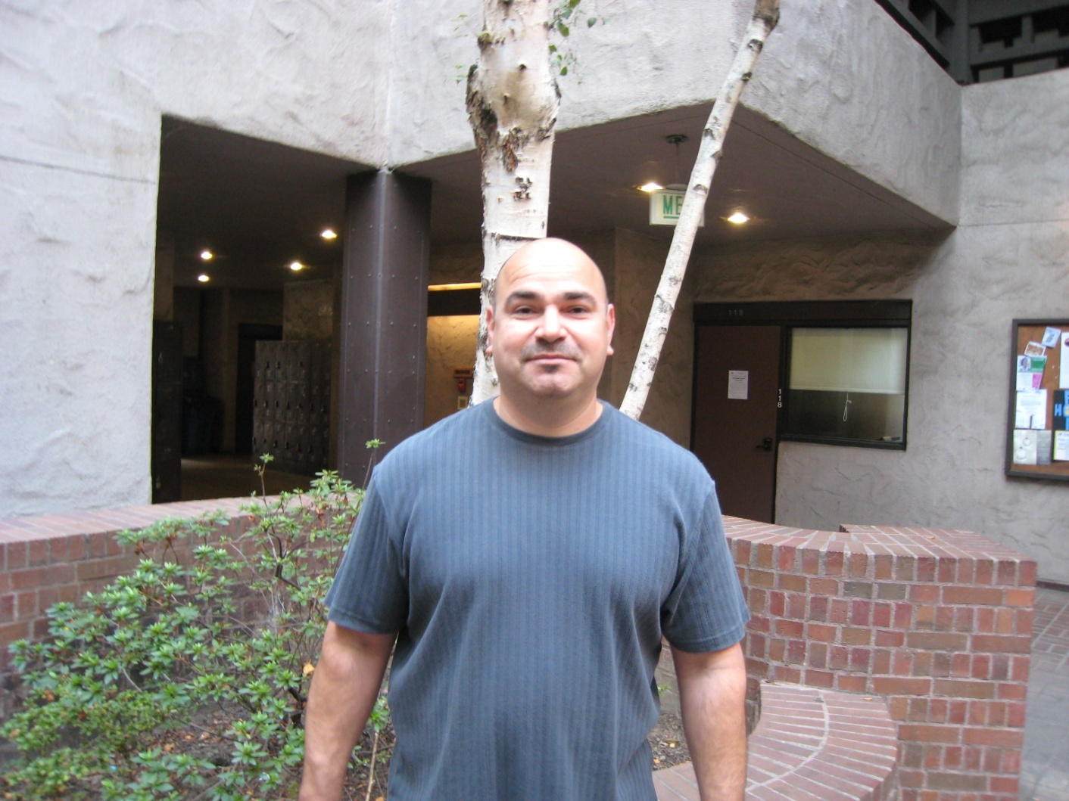
Luis Herrera

Slide 62
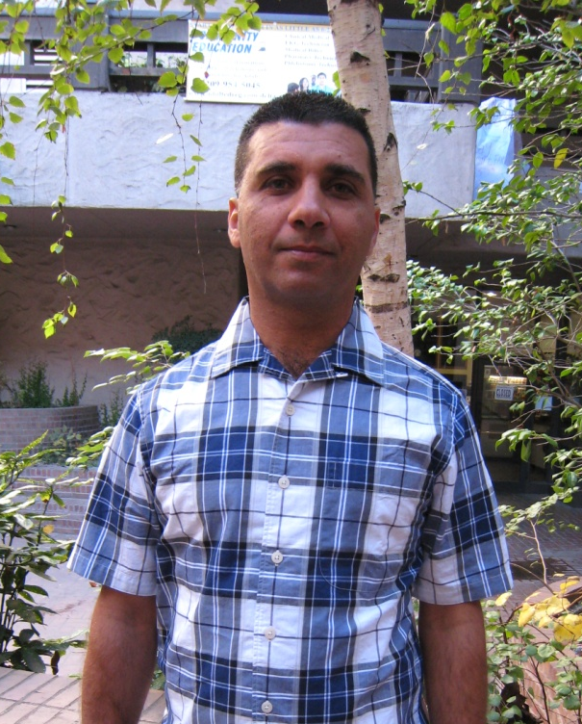
Abdelnessar Annous

Slide 63
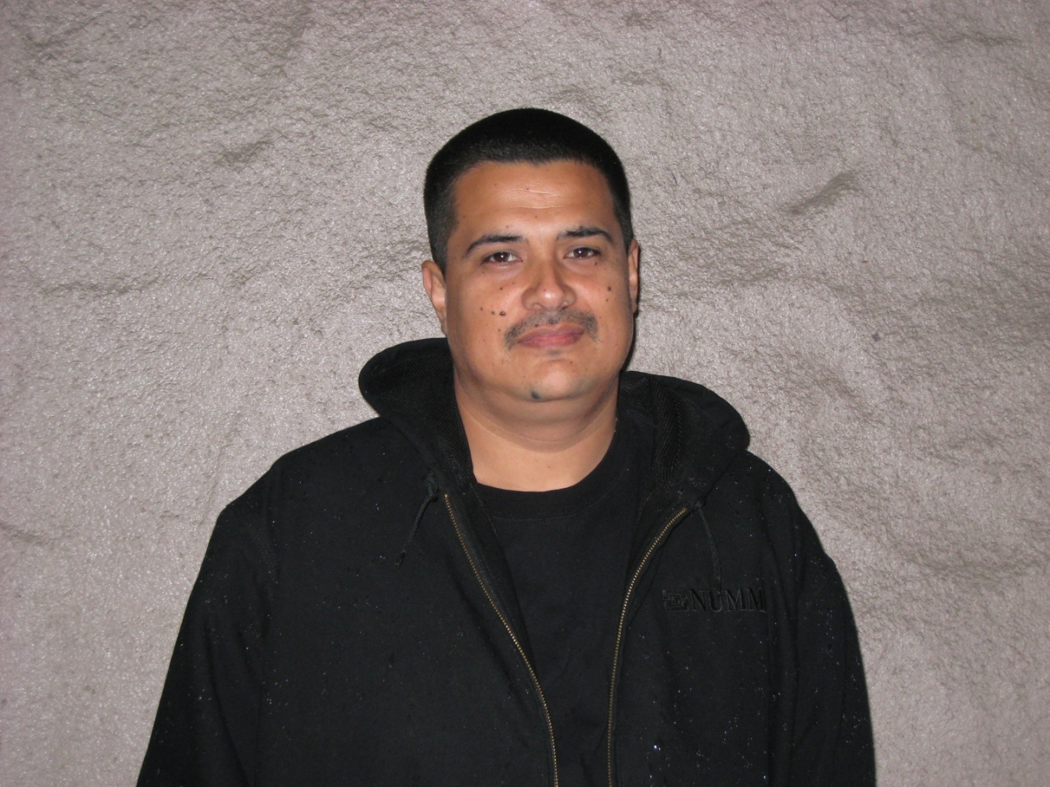
Rosendo Castro

Slide 64
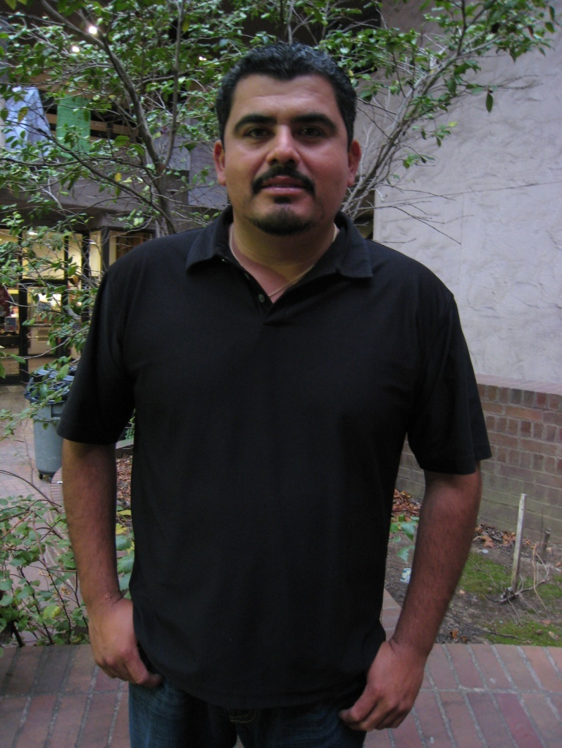
Jose Guerrero

Slide 65
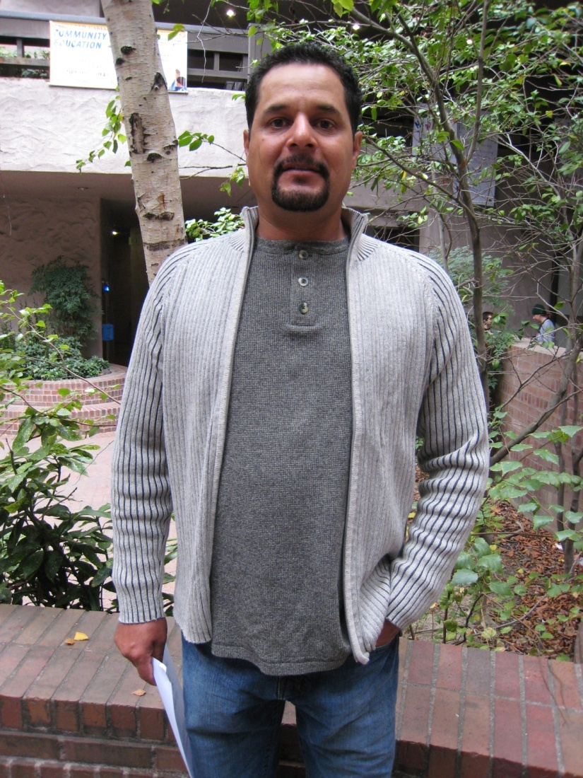
Samuel Manzo

Slide 66
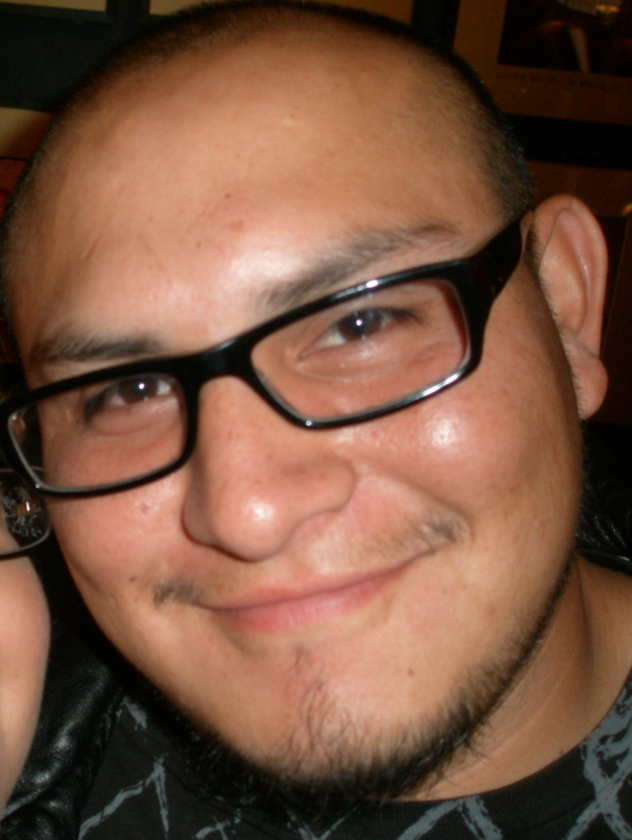
Fernando Rangel

Slide 67
Juan Reyes

Slide 68
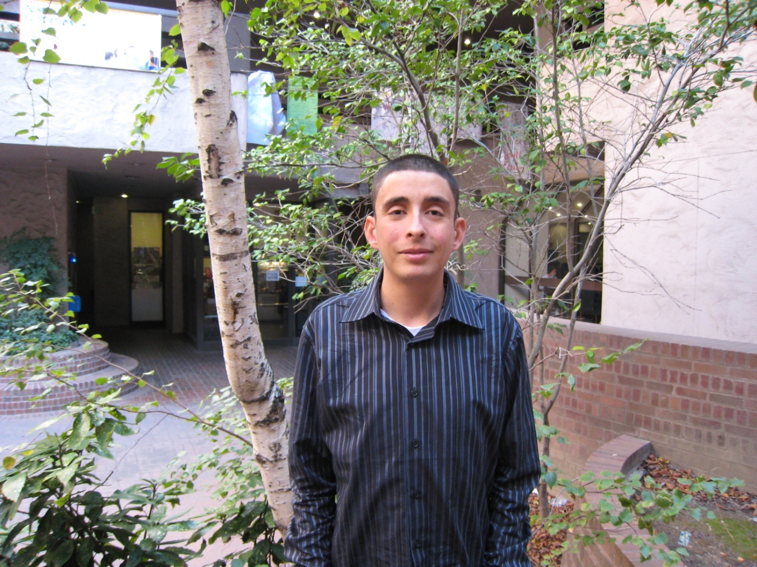
Diego Serrato

Slide 69
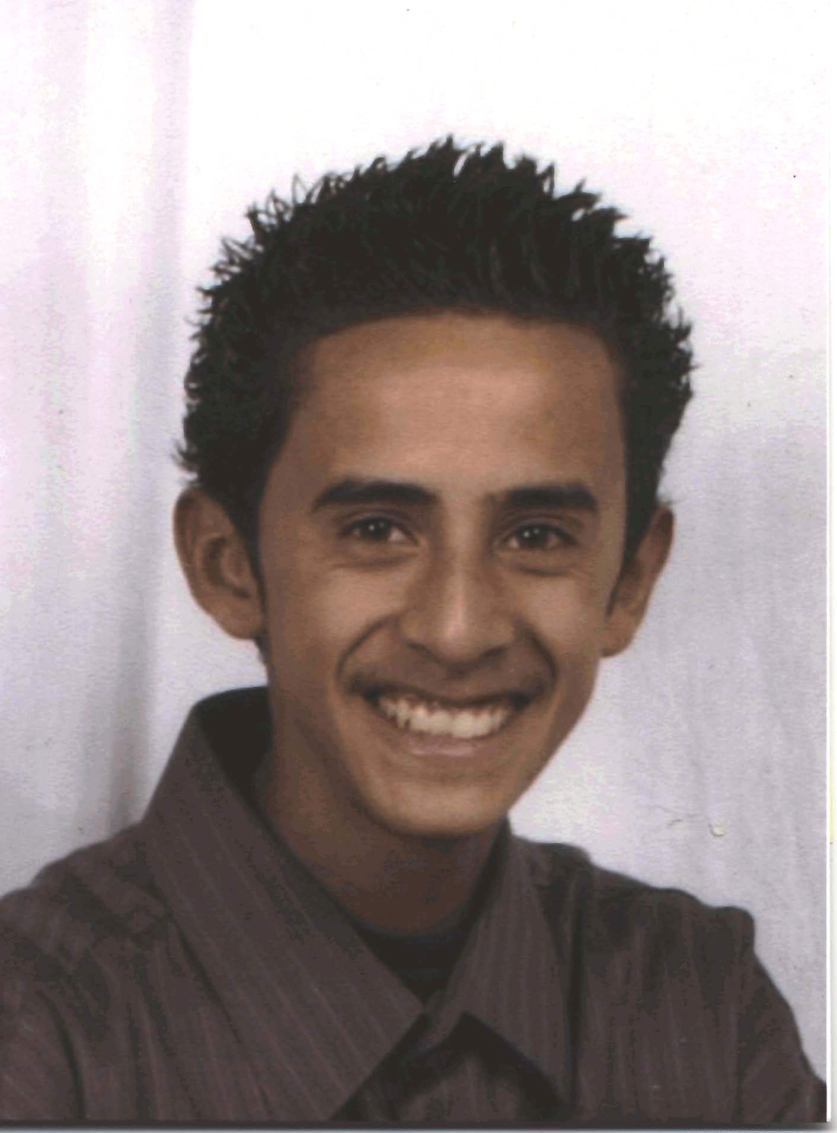
Ricardo Zambrano

Slide 70
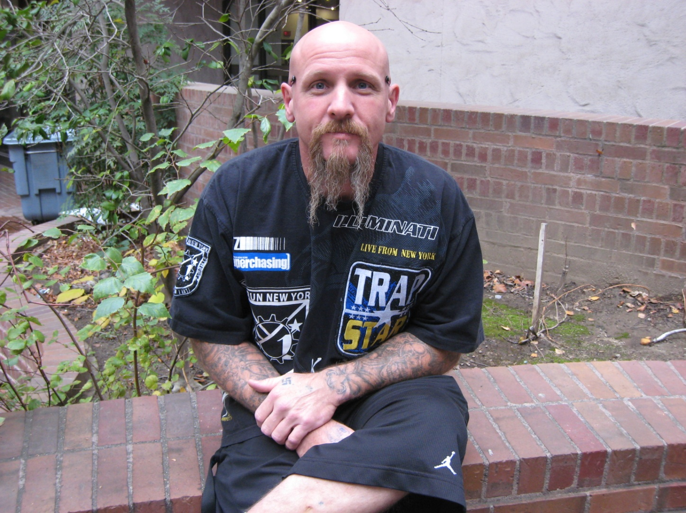
Sean Griffith

Slide 71
Congratulations to all students, their families & significant others!

