Slide 1
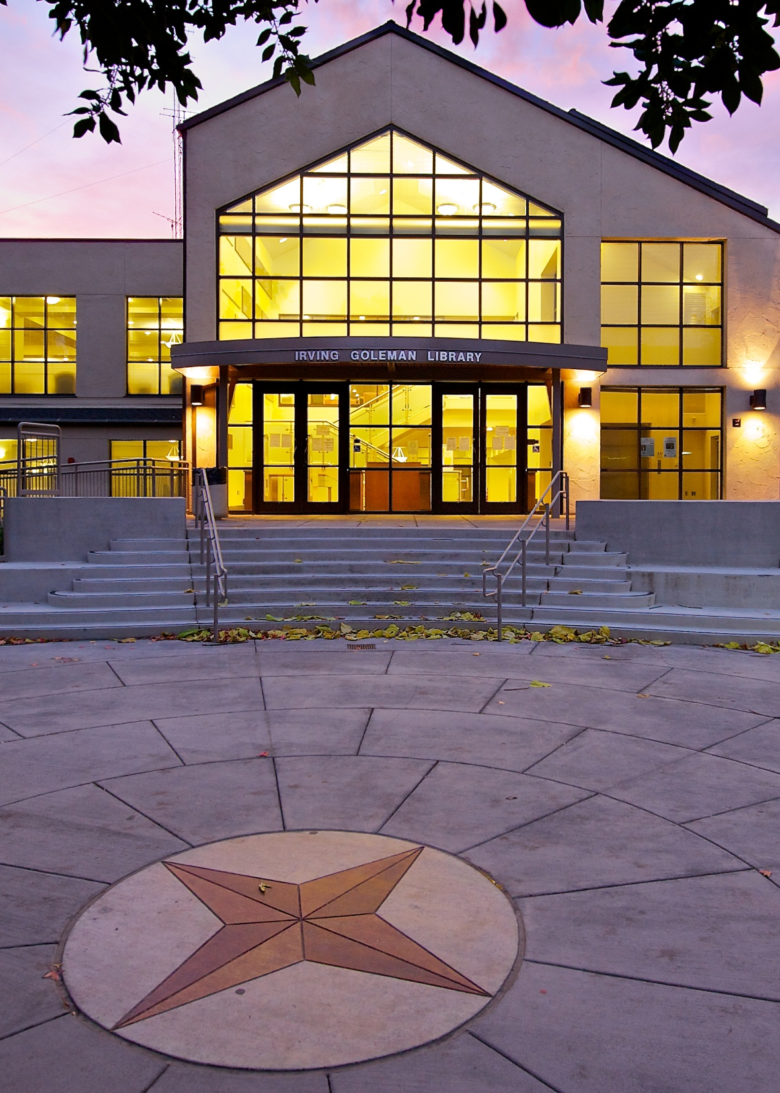
New Faculty Academy
An Orientation to Library Resources and Services
Dr. Jun Wang
Professor of Library & Information Studies
Senior Librarian Adviser
Coordinator of Bibliographic Instruction and Information Literacy

Slide 2
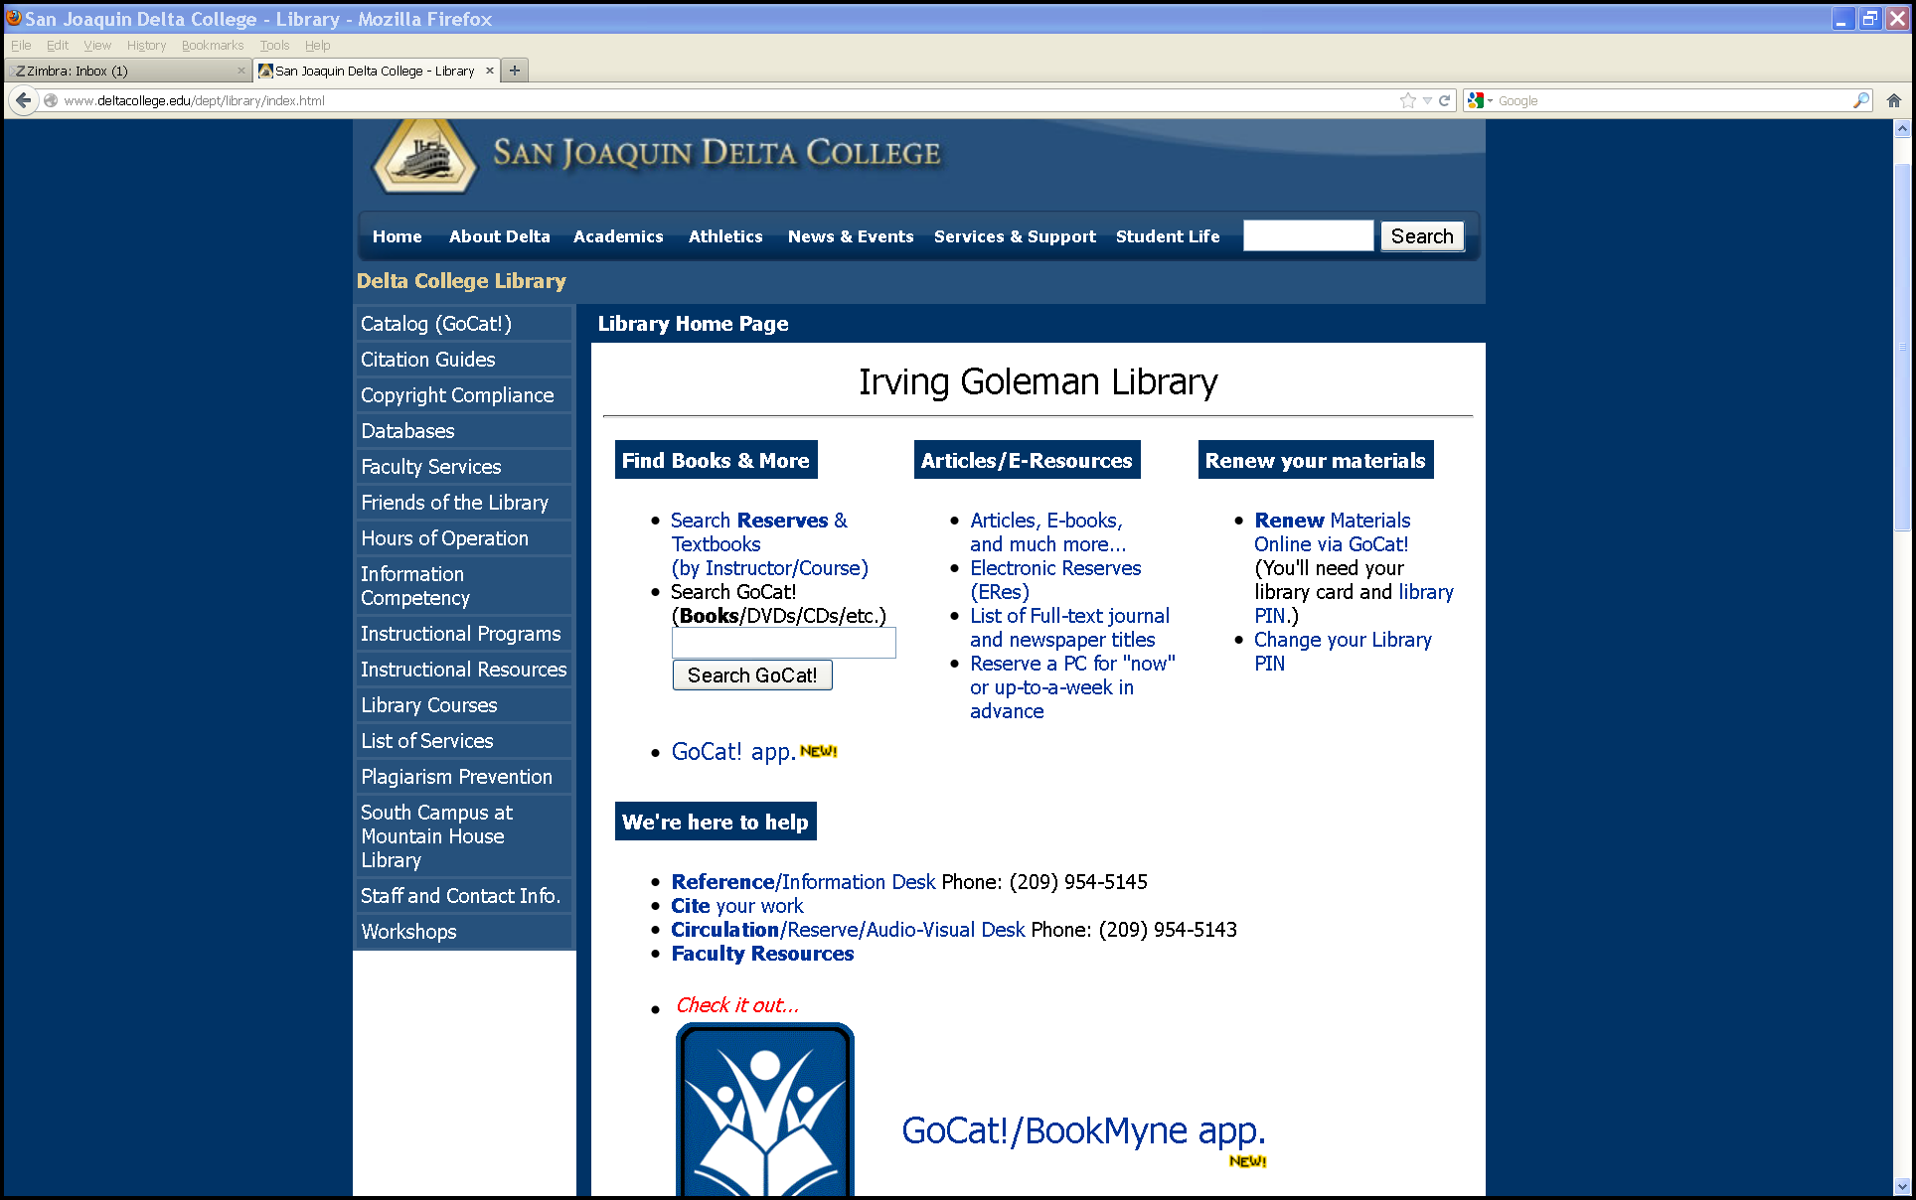
Library Resources & Services for Faculty
Library’s Home Page: http://library.deltacollege.edu

Slide 3

GoCat: A Handy Tool for Faculty
Available to users 24/7
No password is needed to use it
Used to find out what is available from the library’s collections (books, e-books, audiovisual materials, textbooks, Reserved Items, etc.)

Slide 4
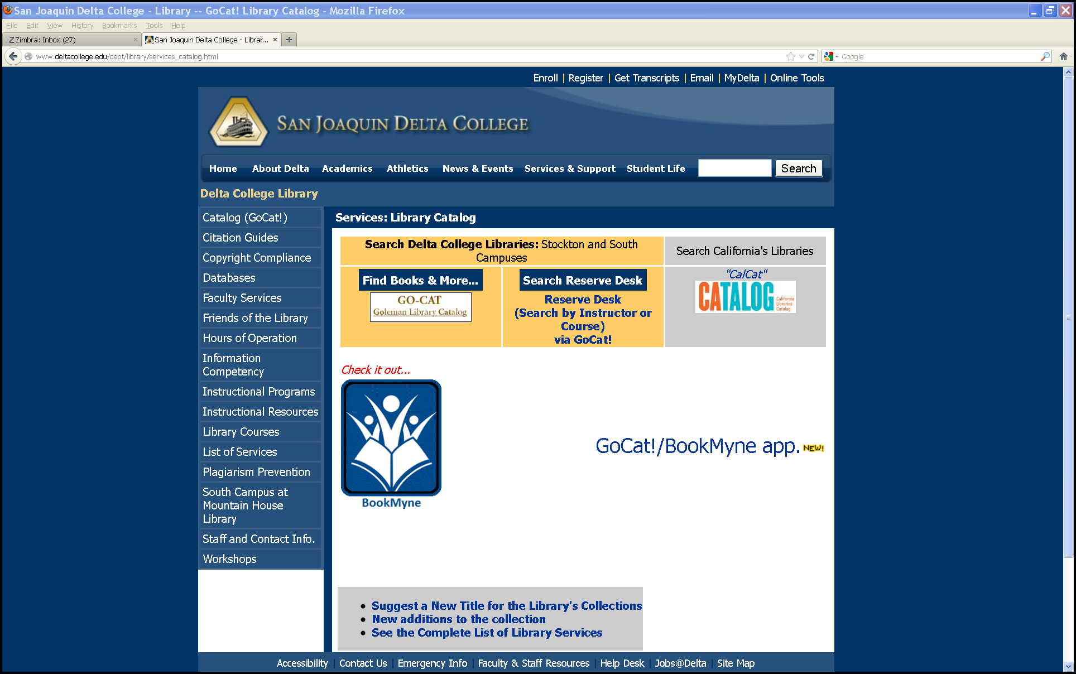

Slide 5
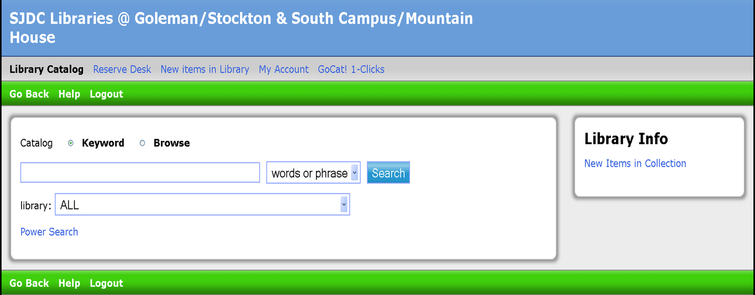
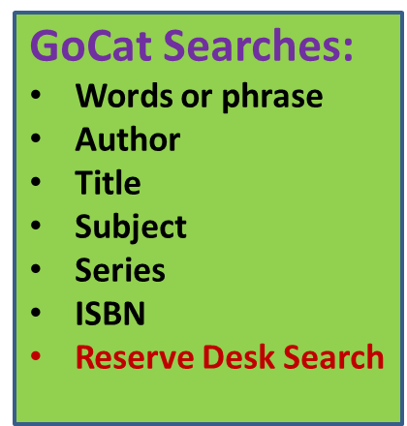
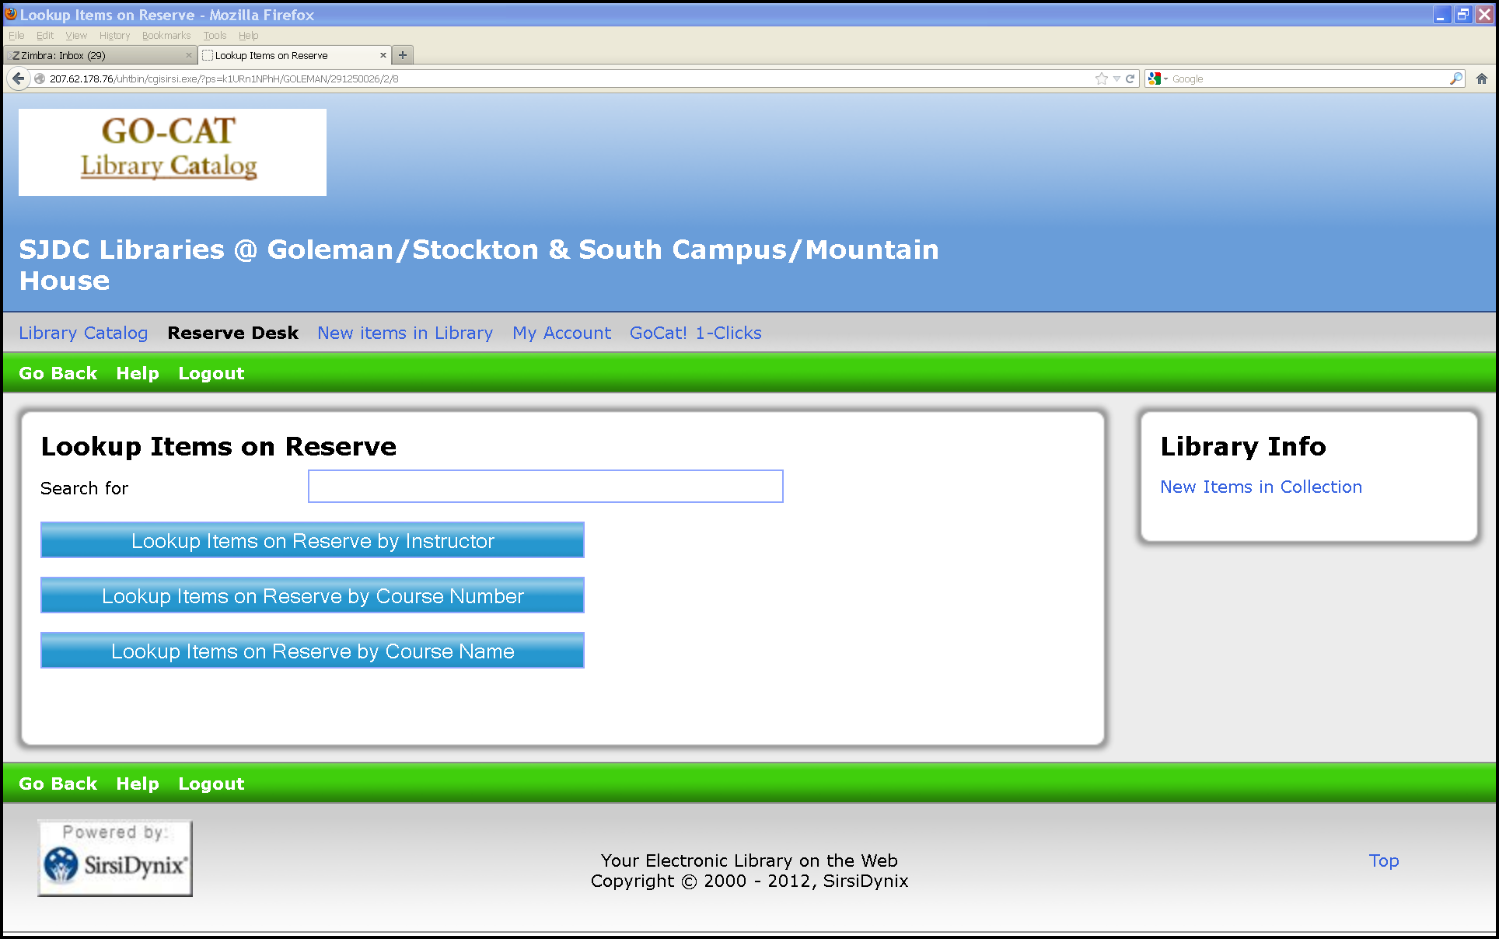
Types of Searches in the Catalog

Slide 6
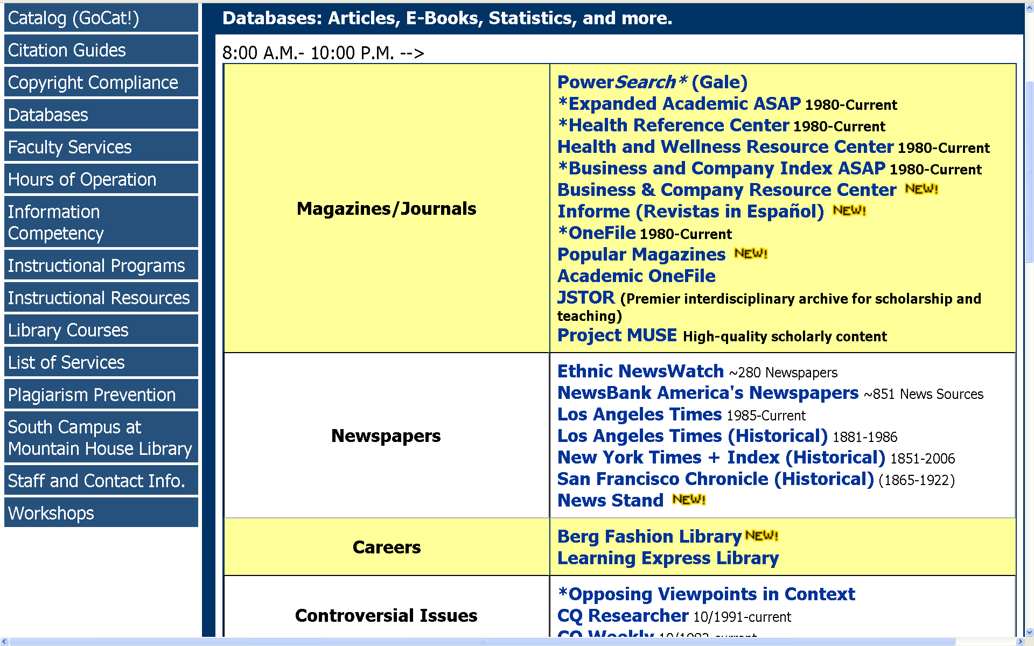

Slide 7
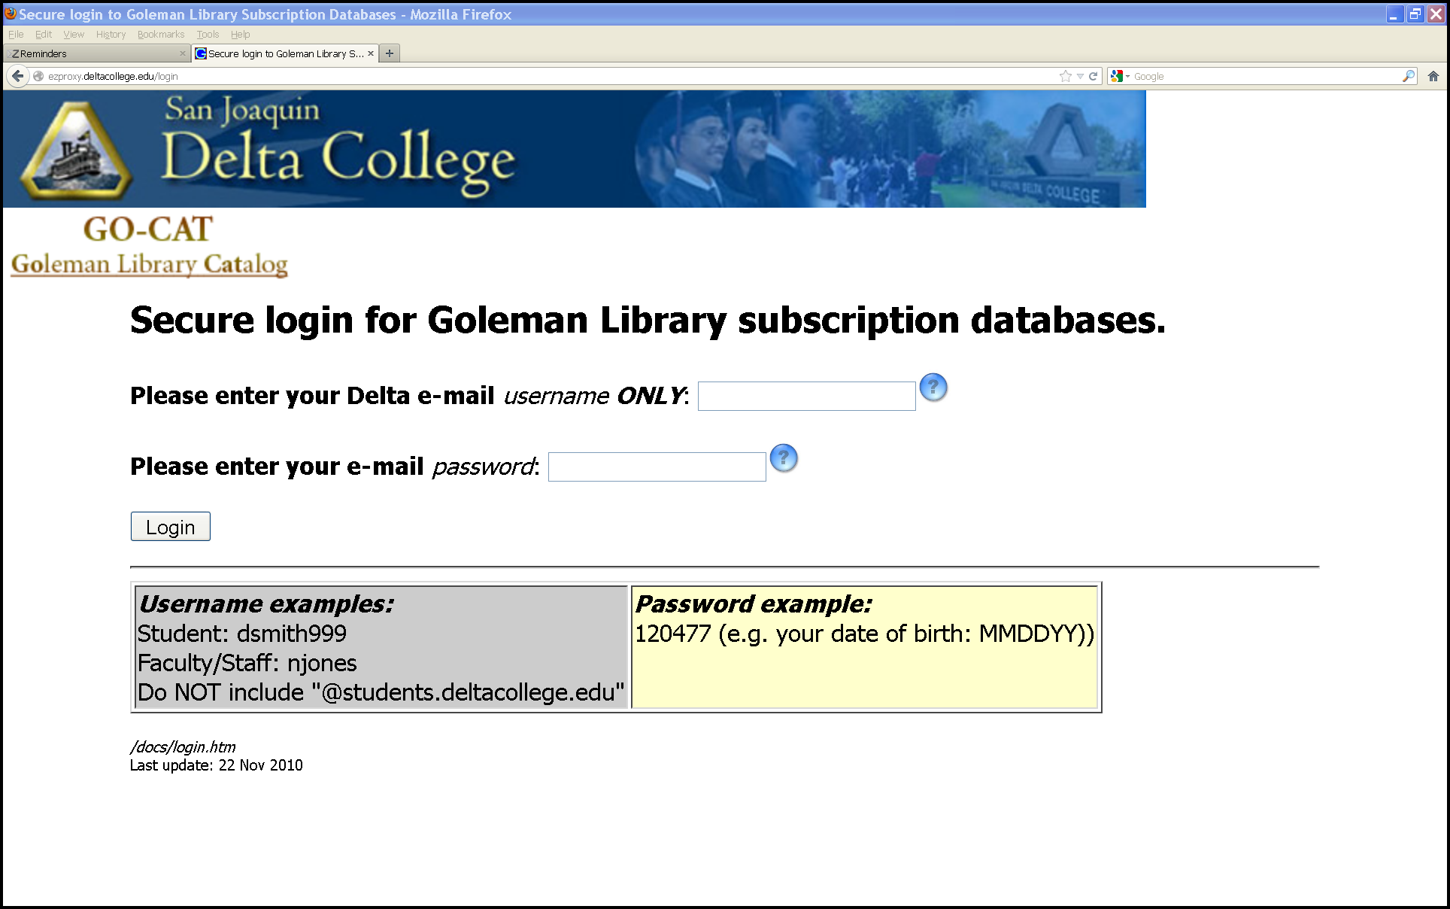
Faculty Login:
Delta e-mail user ID and password

Slide 8
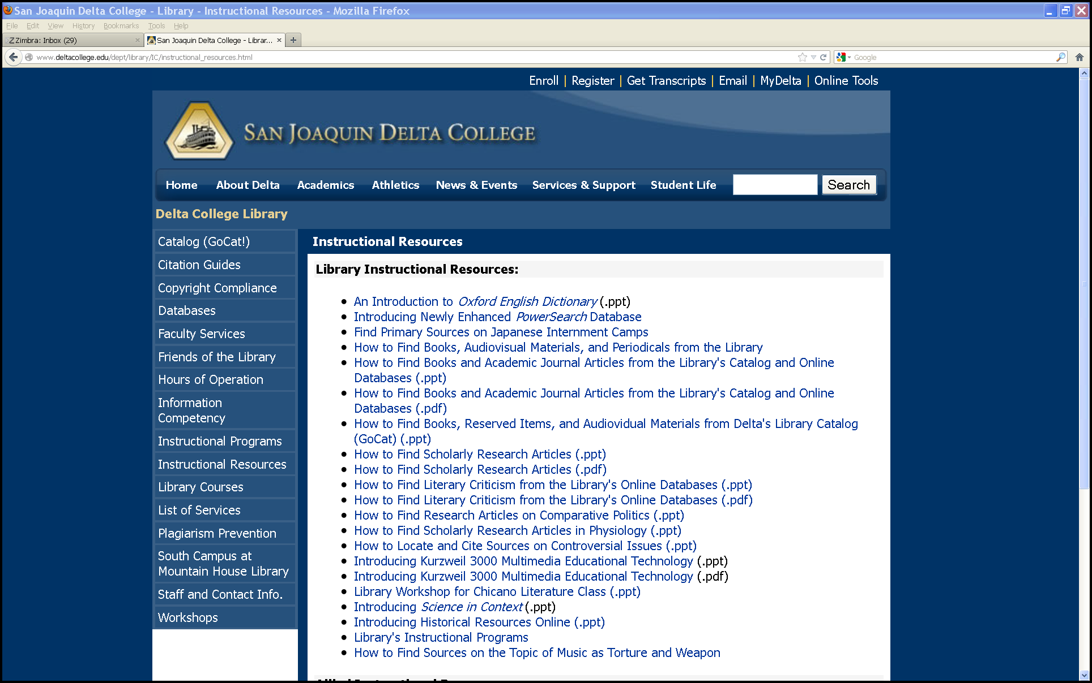
Library Instructional Resources

Slide 9
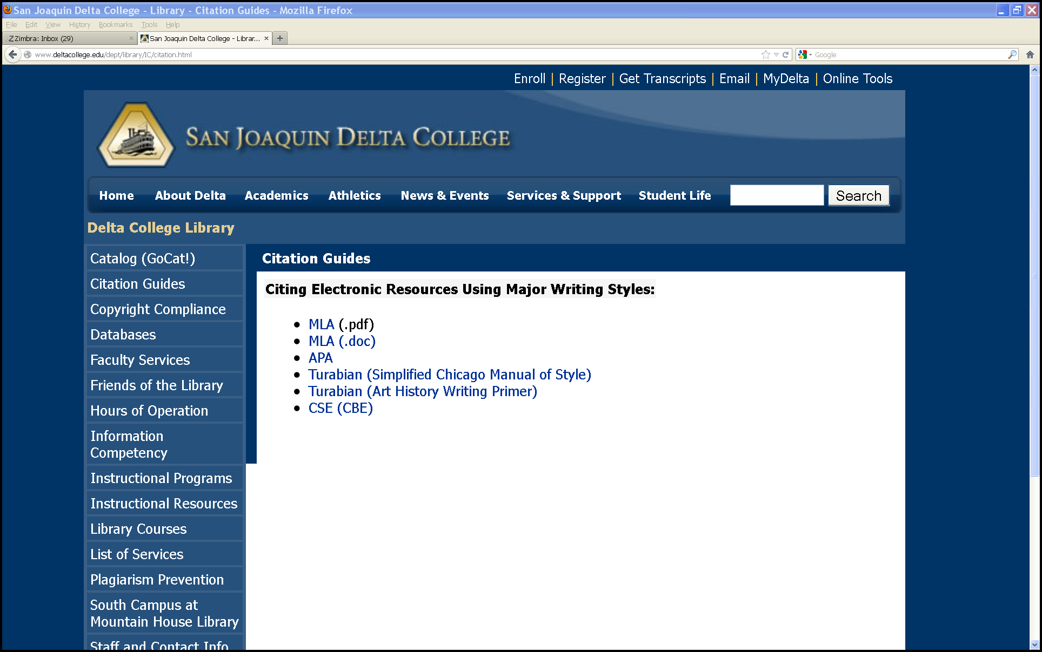
Citation Guides

Slide 10
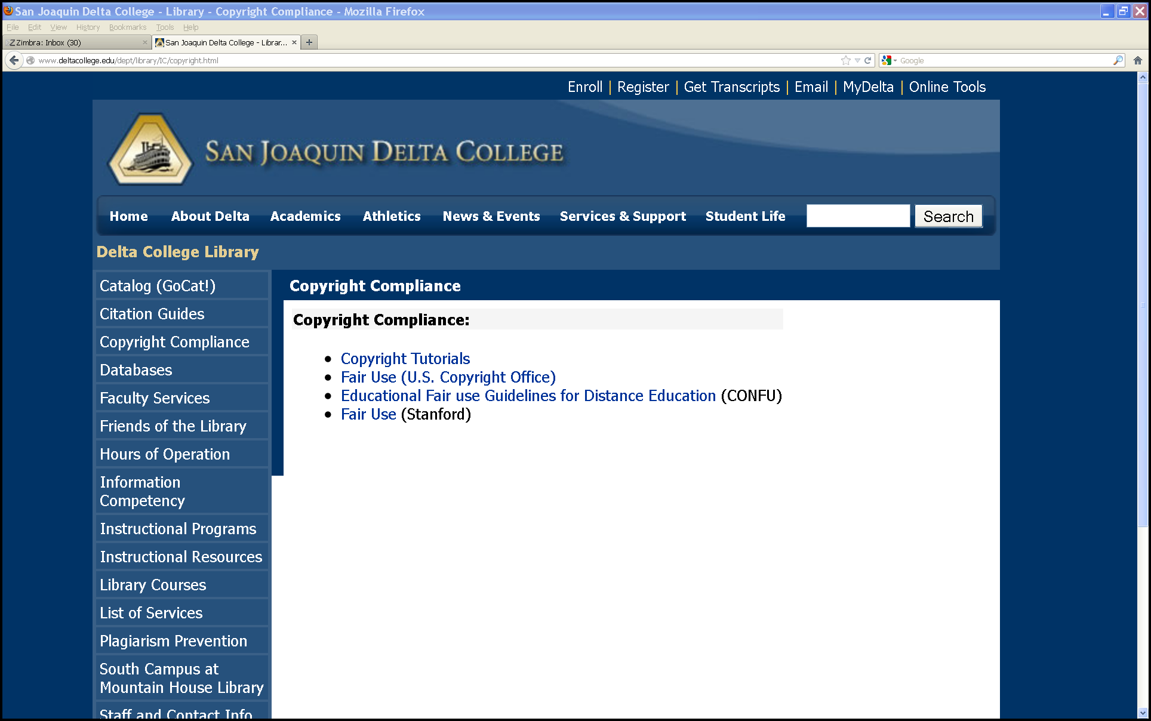
Copyright Compliance

Slide 11
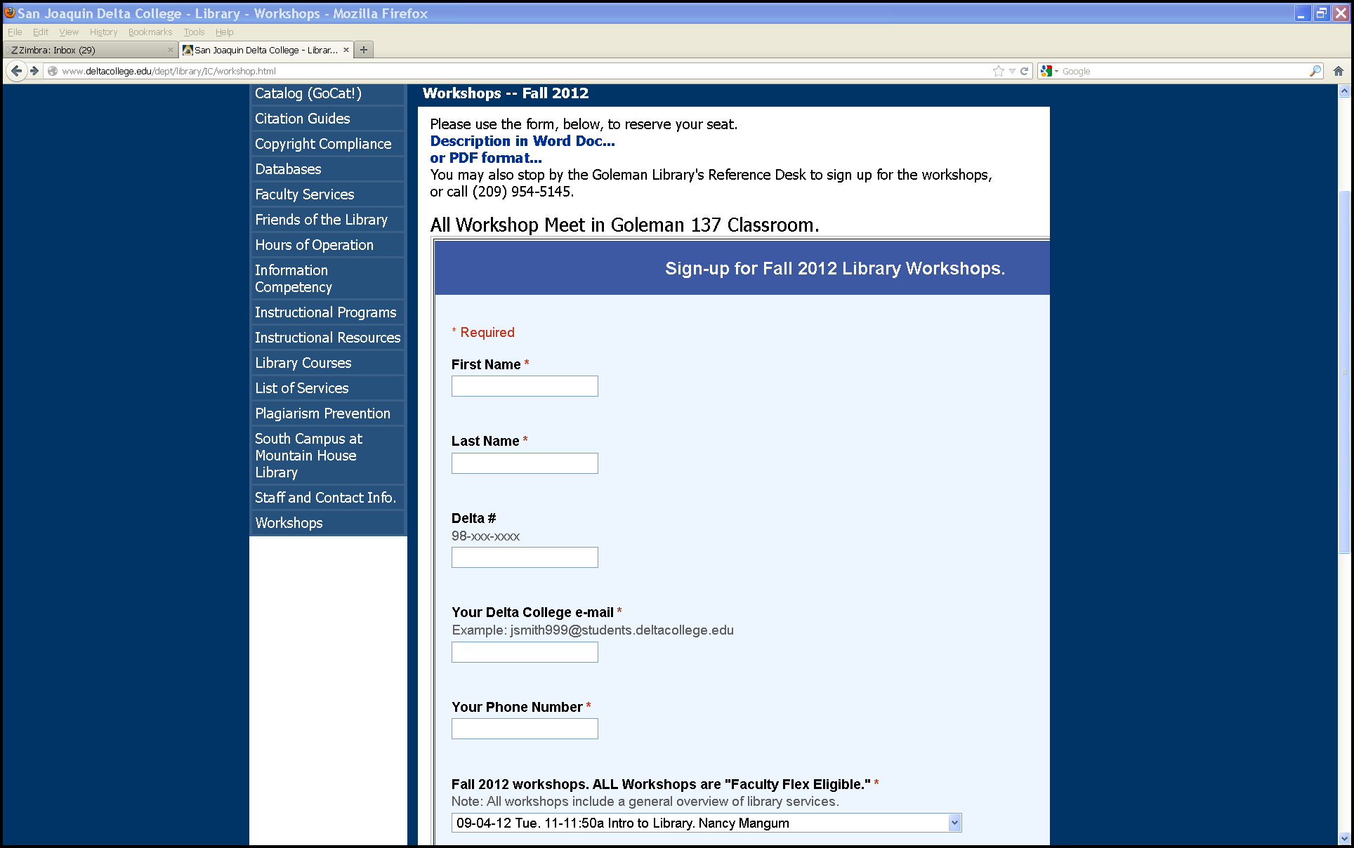
Library Workshops

